Slide 1
Powerpoint 9: Flemish and Dutch Art in the 17th Century

Slide 2
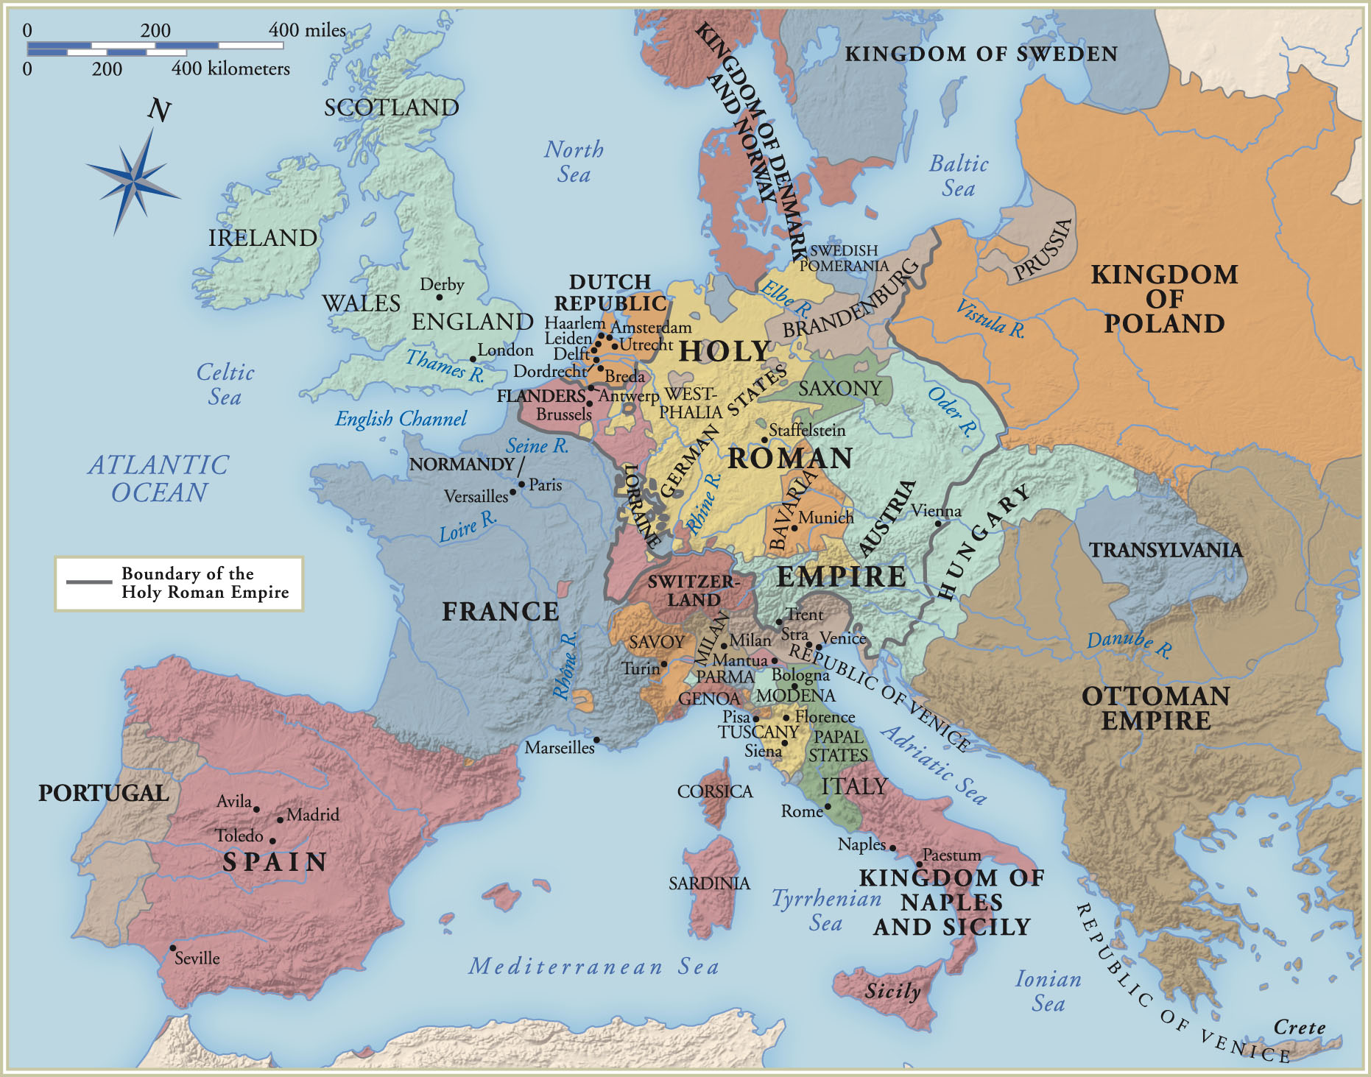
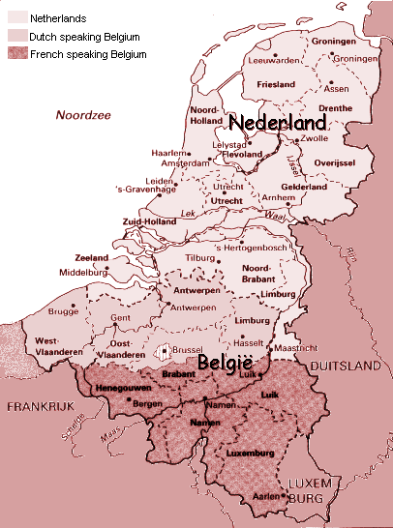
map of the Low Countries with linguistic boundaries

Slide 3
(Map 25-1) Seventeenth-Century Europe

Slide 4
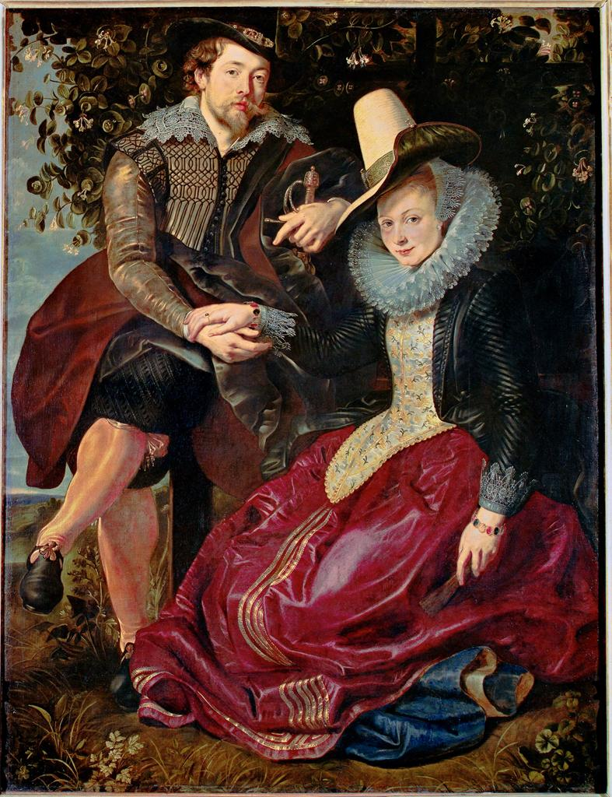
Peter Paul Rubens, Self Portrait with his wife Isabella Brandt, 1609-10

Slide 5
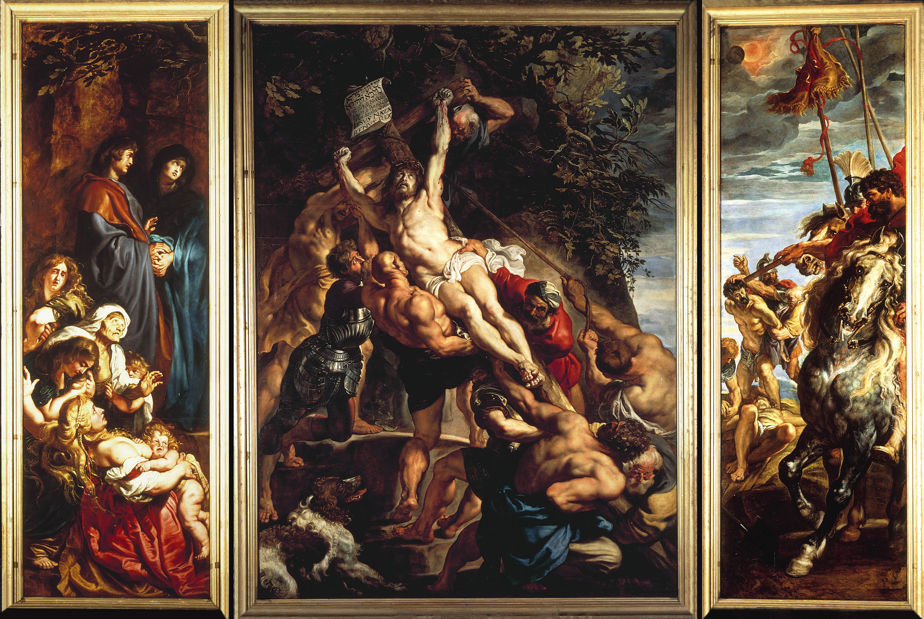
@ (25-2) Peter Paul Rubens, Elevation of the Cross, for Church of S. Walburga, Antwerp, 1610-11

Slide 6
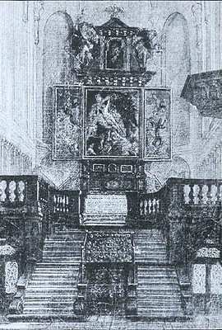
print showing the altarpiece in its original position

Slide 8
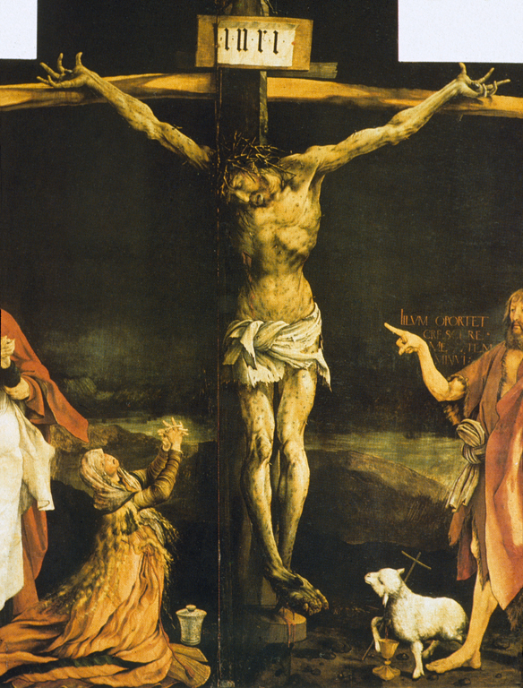
(23-2) det. of Christ from Matthias Grunewald, Isenheim Altarpiece (closed), c. 1510-15

Slide 9
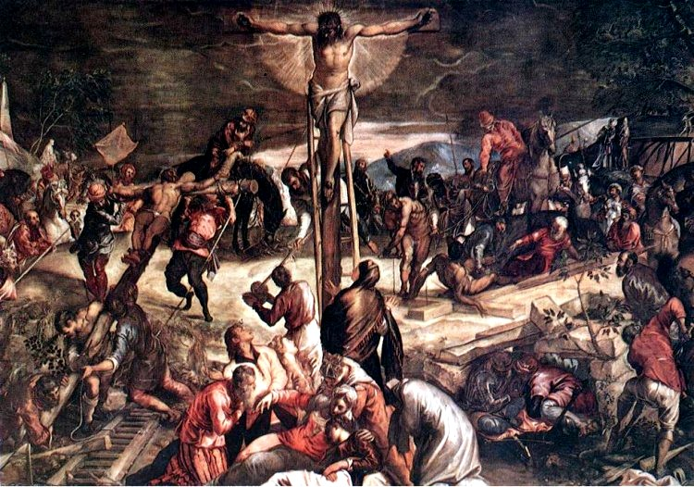
Tintoretto, Scene of the Crucifixion, Scuola di San Rocco, Venice

Slide 10
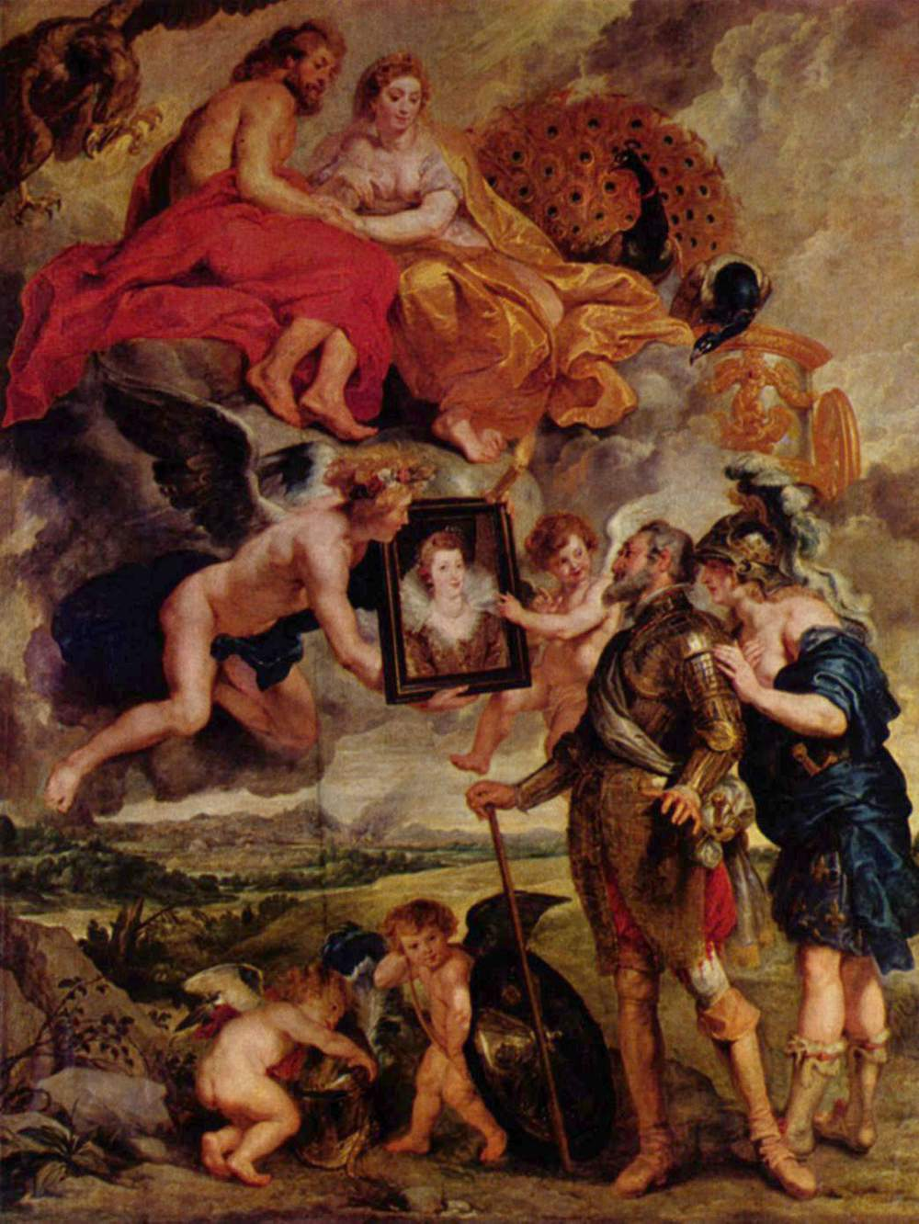
Peter Paul Rubens, Henry IV receiving the portrait of Maria de’ Medici, 1621-25

Slide 11
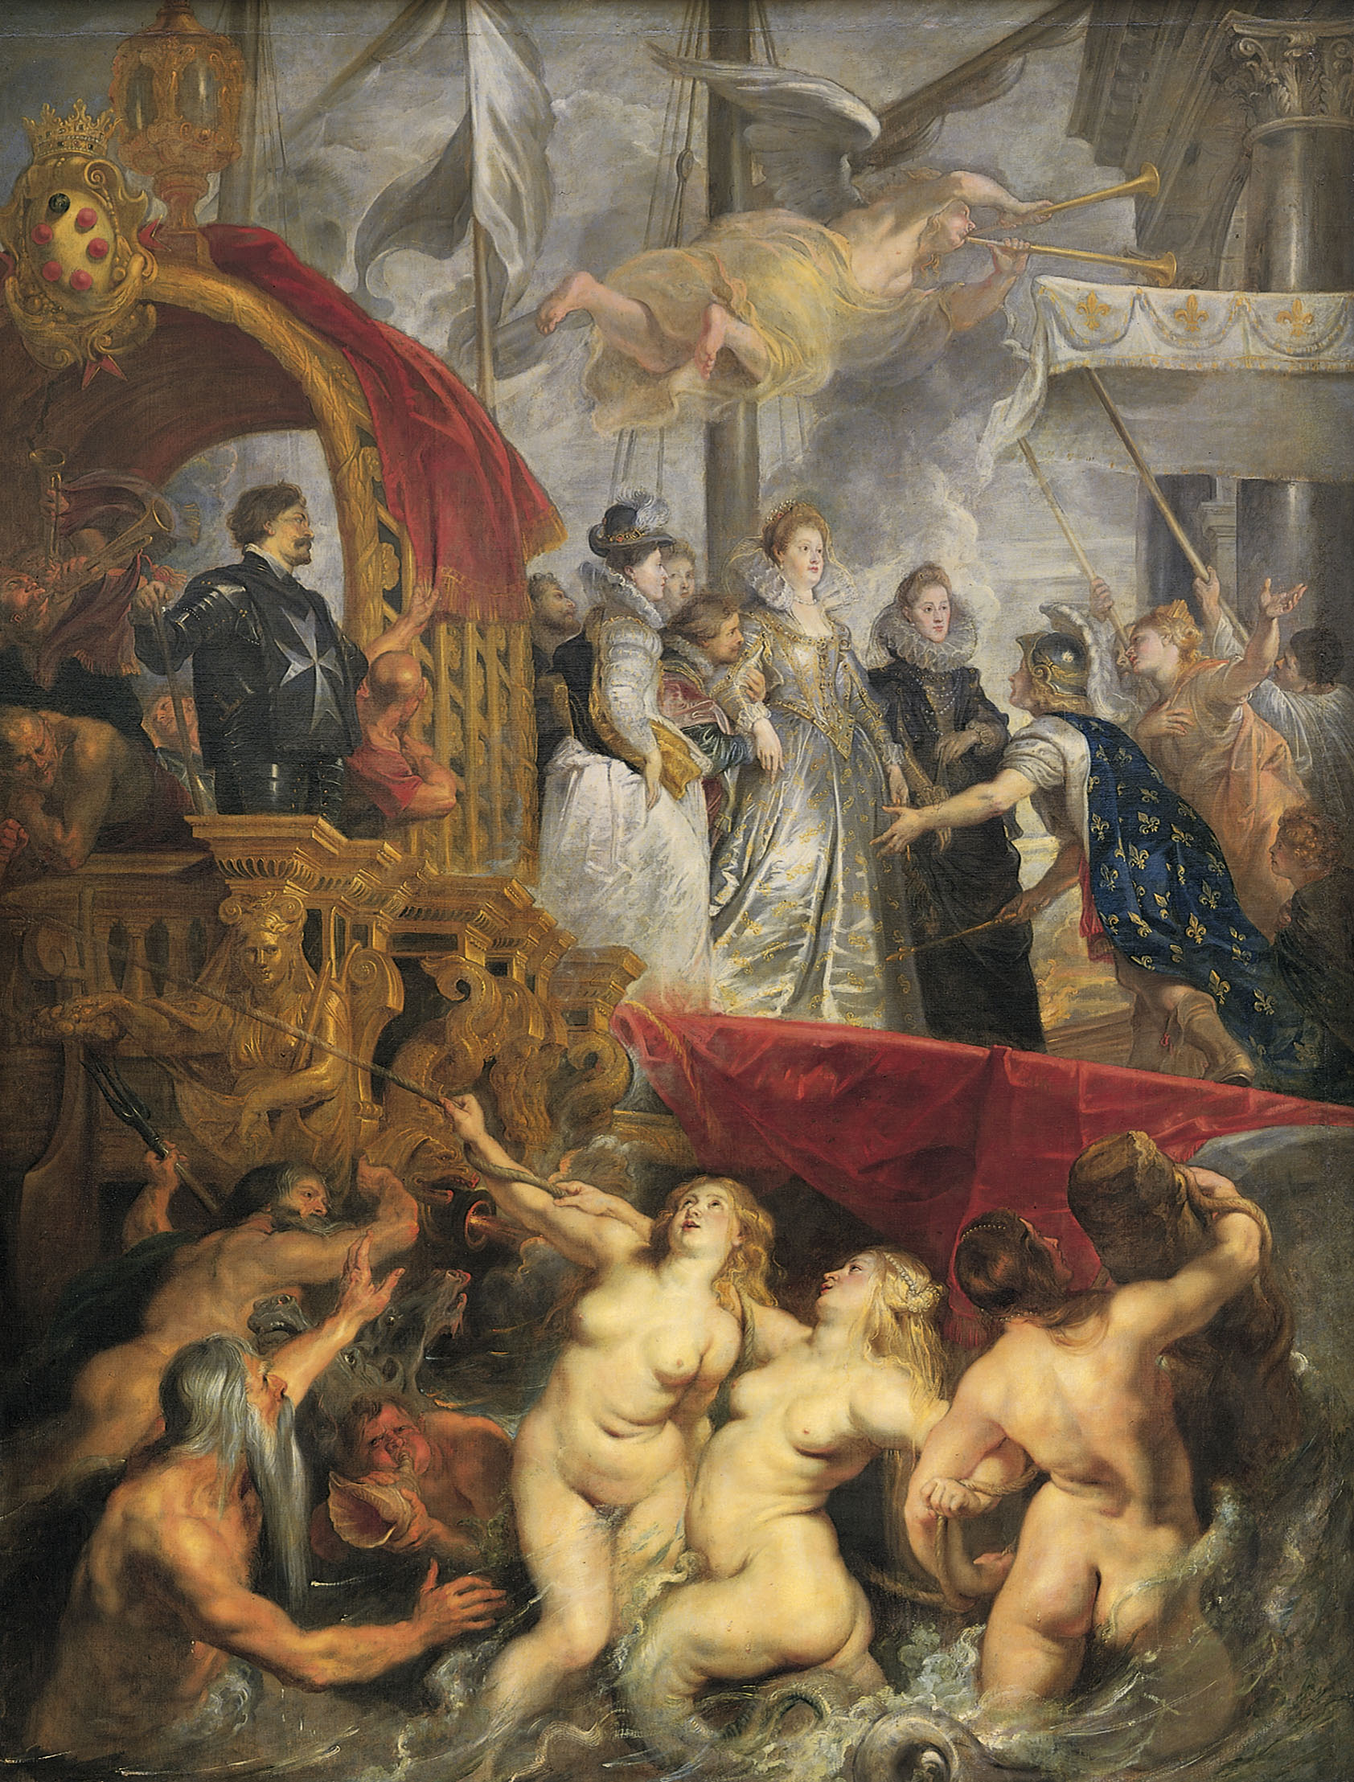
@ (25-4) Peter Paul Rubens, Arrival of Marie de’ Medici at Marseilles, 1622-25

Slide 13
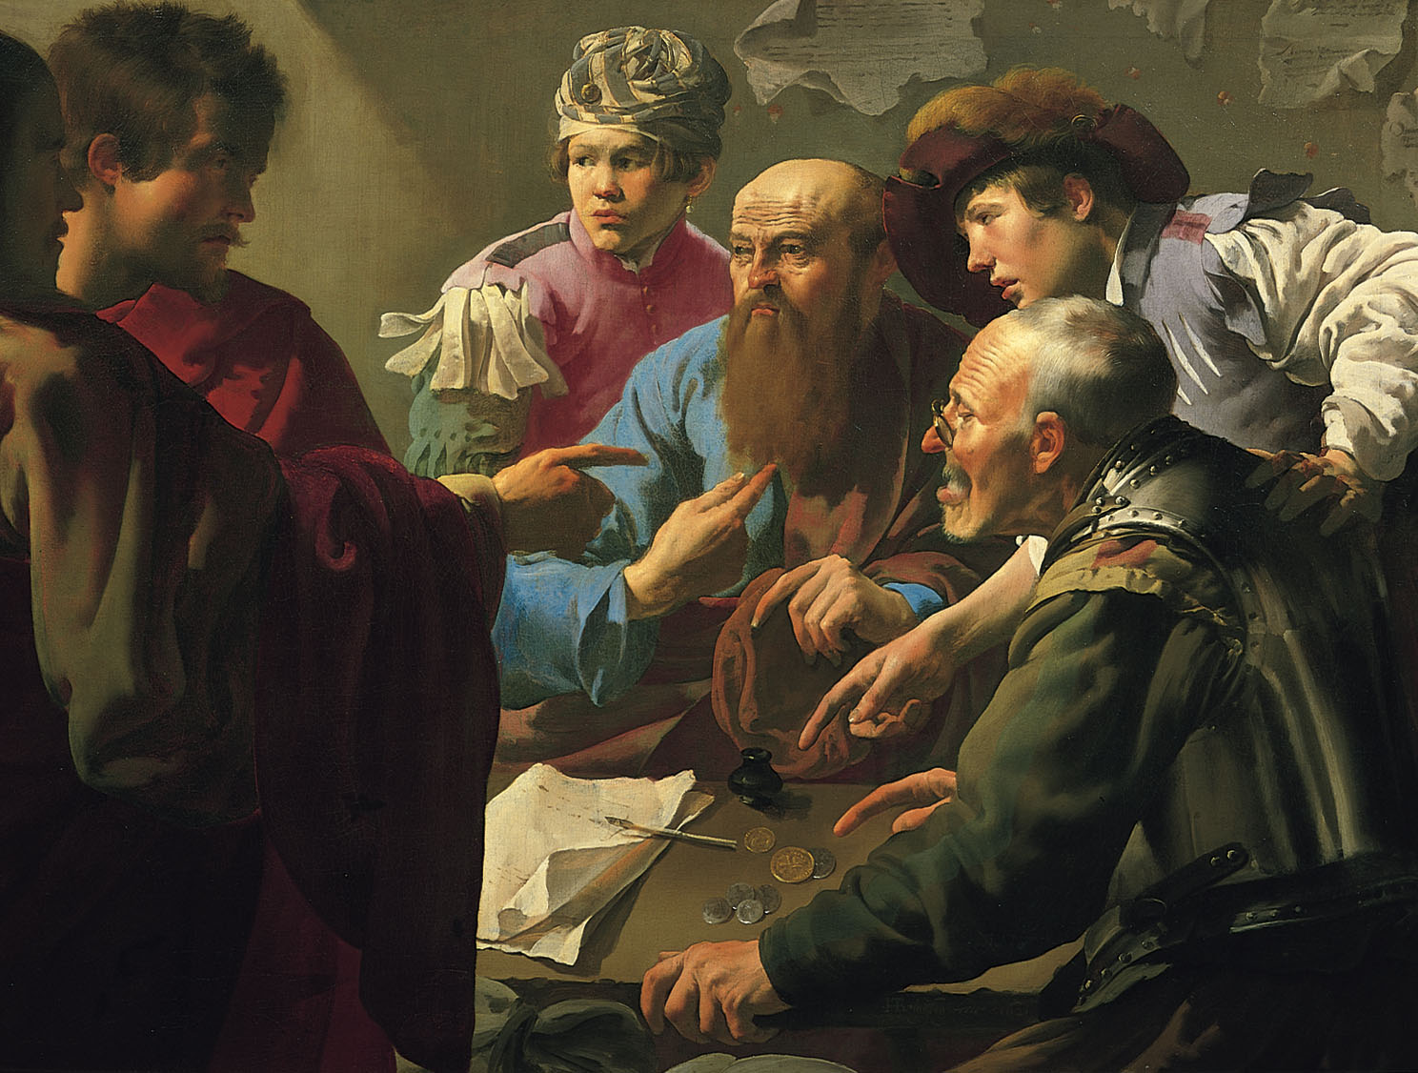
@ (25-7) Hendrick ter Brugghen, Calling of St. Matthew, 1621 (3’4”x4’6”)

Slide 14
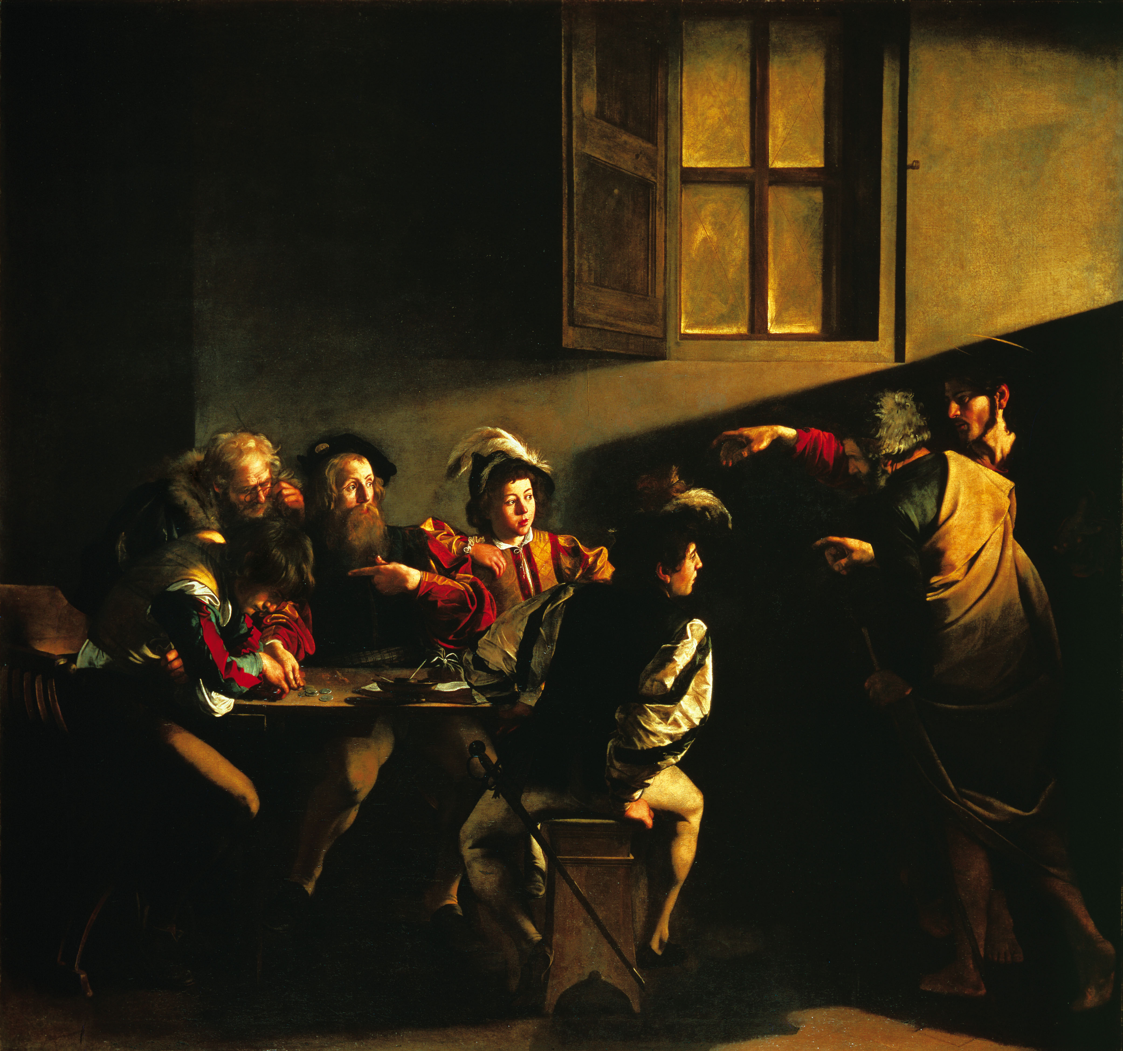
@ (25-7) Hendrick ter Brugghen, Calling of St. Matthew, 1621 (3’4”x4’6”)
(24-18) Caravaggio, Calling of St. Matthew, c. 1597-1601

Slide 16
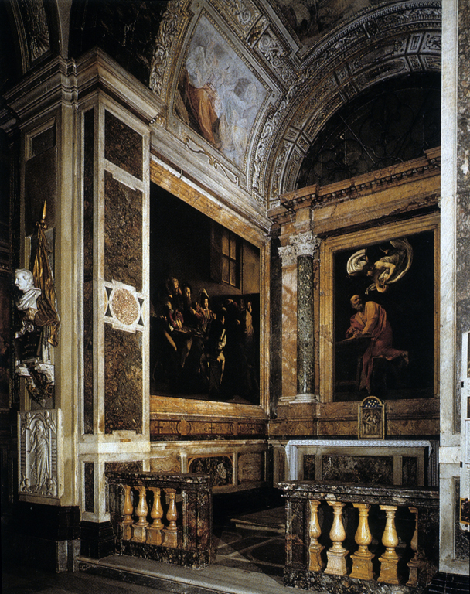
Contarelli Chapel with Caravaggio’s paintings

Slide 17
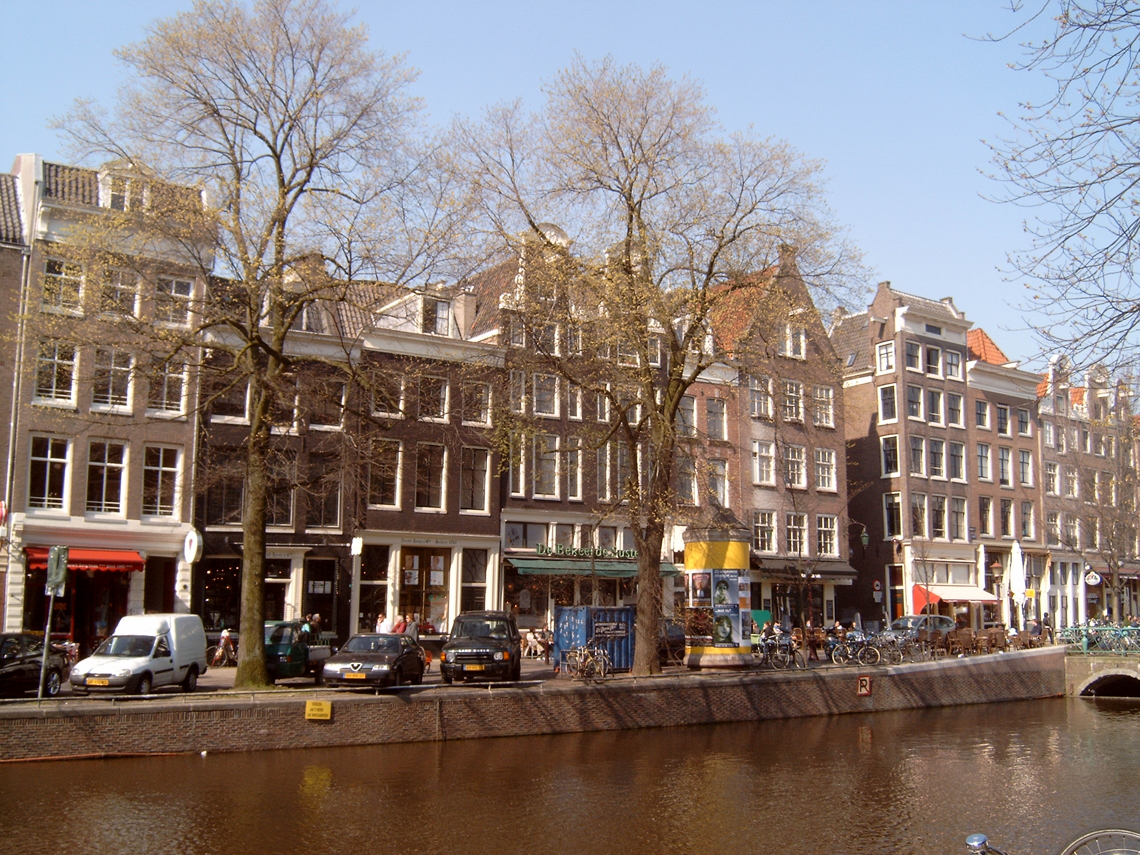
Canal houses in Amsterdam

Slide 18
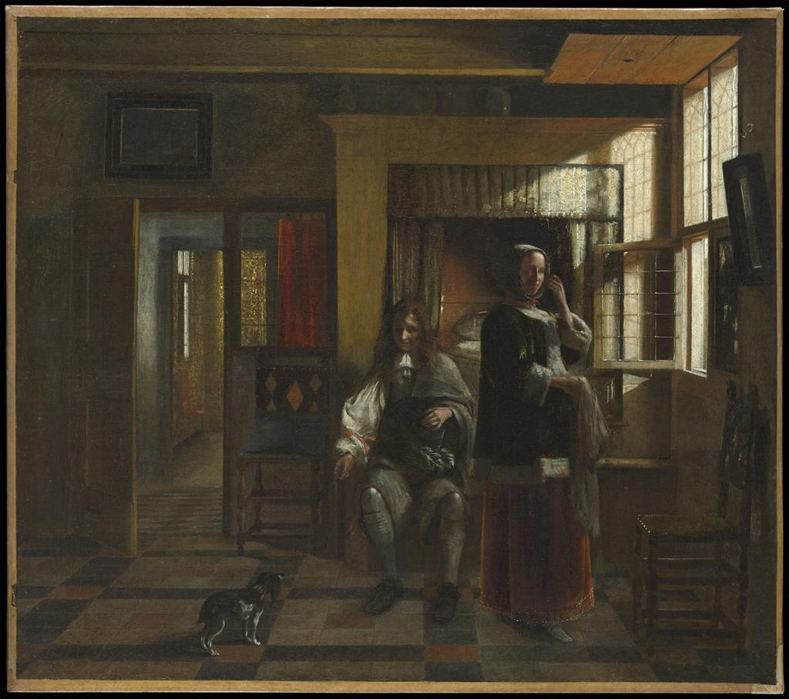
17th Dutch Genre painting by Pieter de Hooch

Slide 19
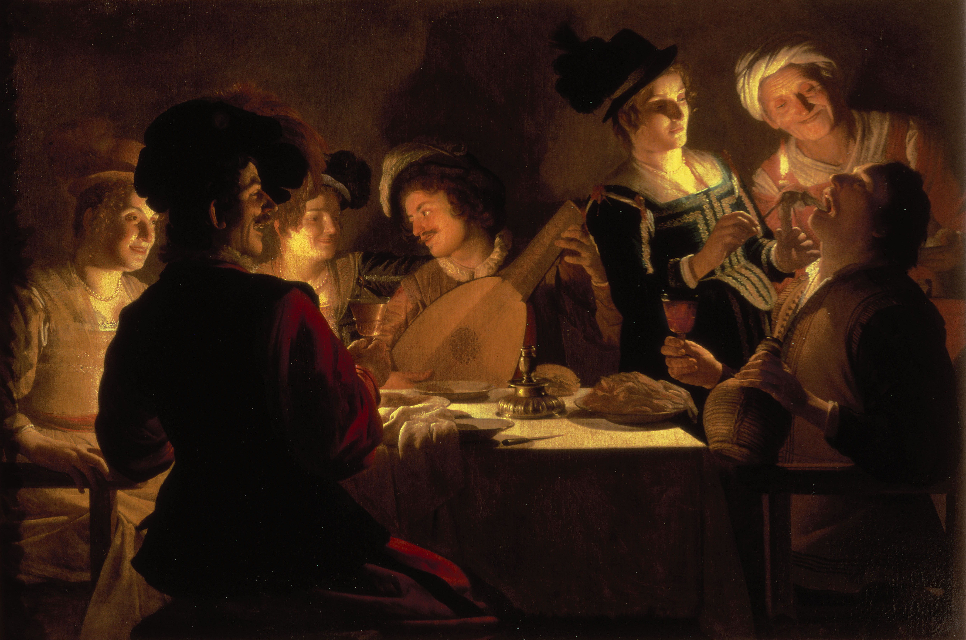
@ (25-8) Gerrit van Honthorst, Supper Party, 1620

Slide 20
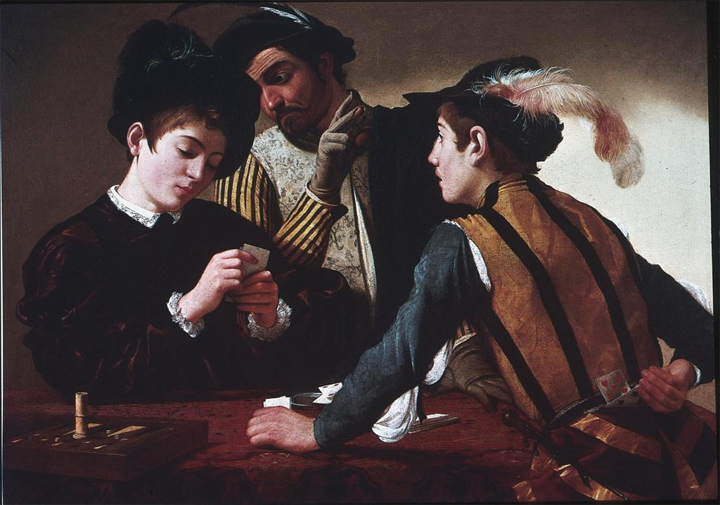
@ (25-8) Gerrit van Honthorst, Supper Party, 1620
Caravaggio, The Card Sharps, c. 1595, Kimball Museum, Fort Worth

Slide 21
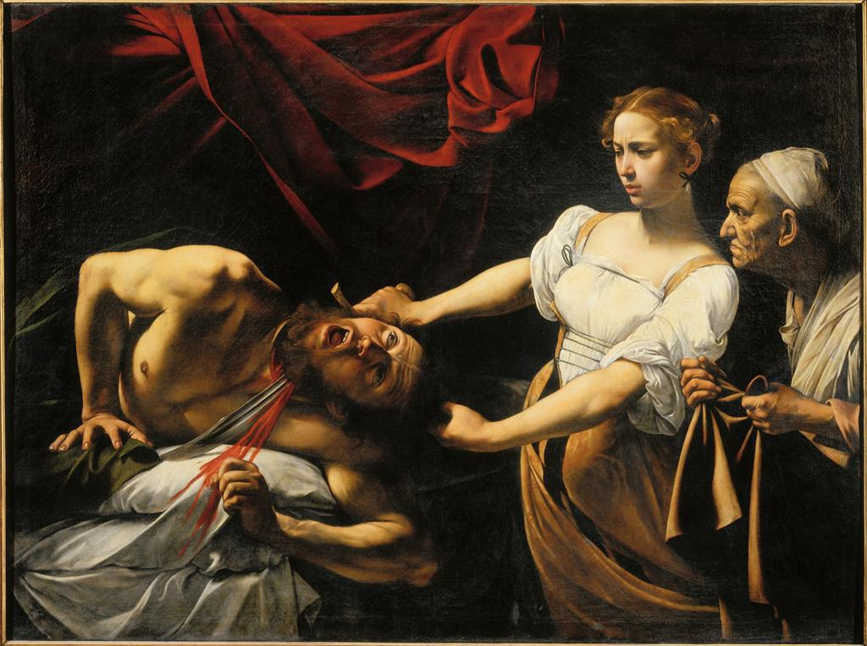
Caravaggio, Judith Beheading Holofernes, c. 1598-99

Slide 22
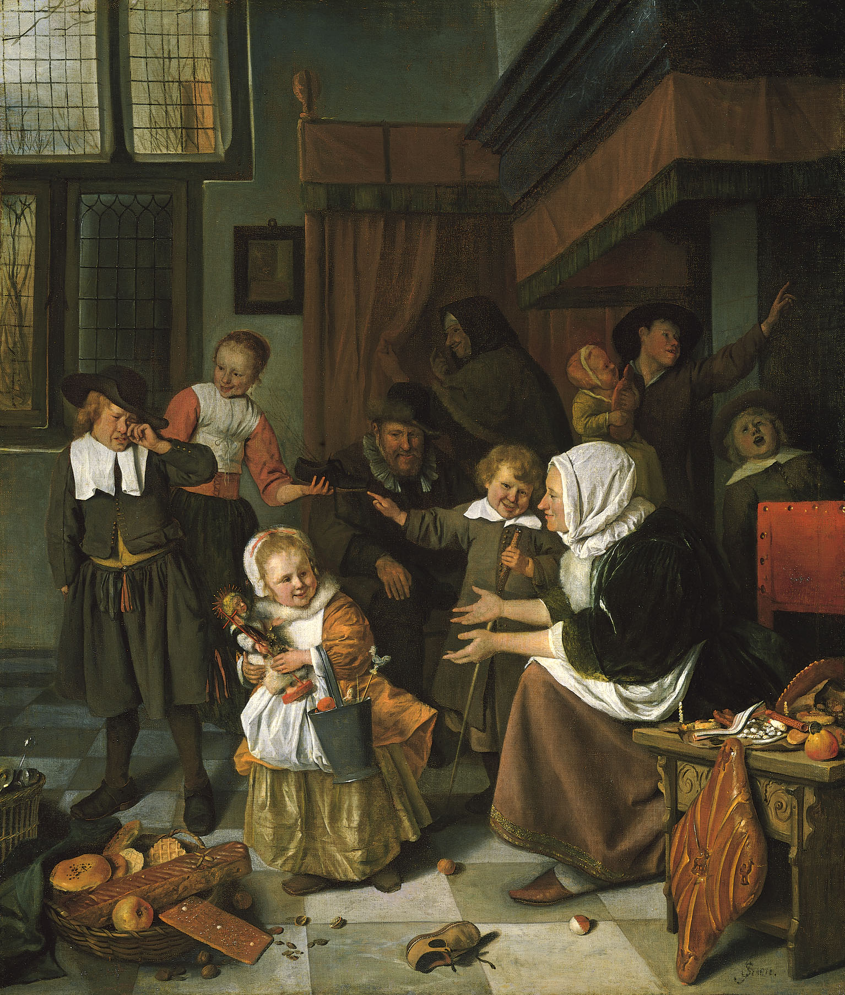
@ (25-20) Jan Steen, The Feast of St. Nicolas, c. 1660-65

Slide 23
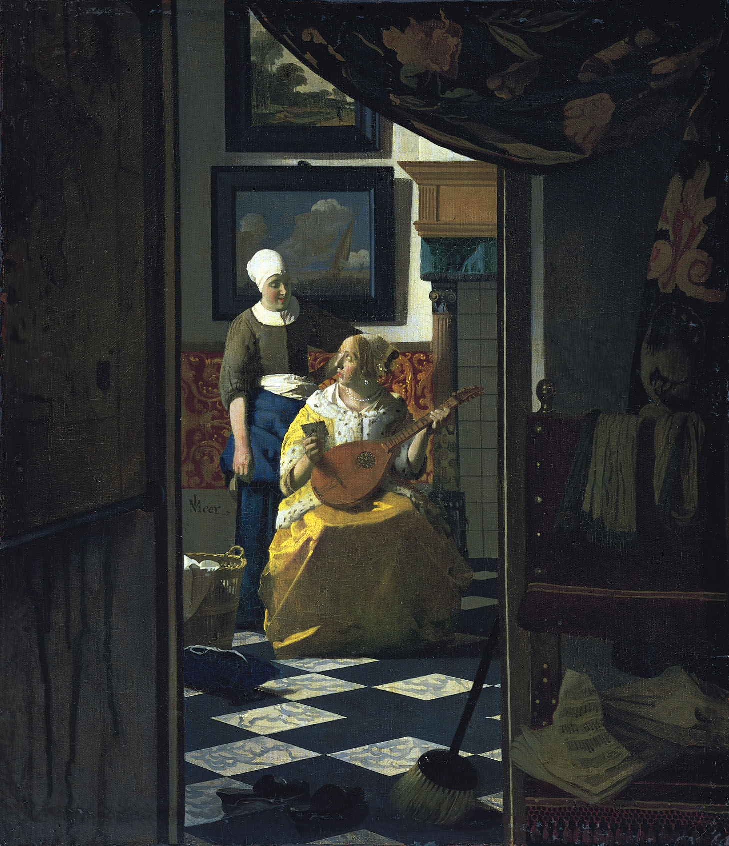
@ (25-18C) Johannes Vermeer, The Letter, c. 1666

Slide 24
“Antiek” and “modern” (seventeenth-century Dutch terms)
Johannes Vermeer, The Letter, c. 1666

Slide 26
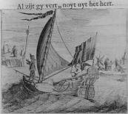
engraved illustration: the ship of love

Slide 27
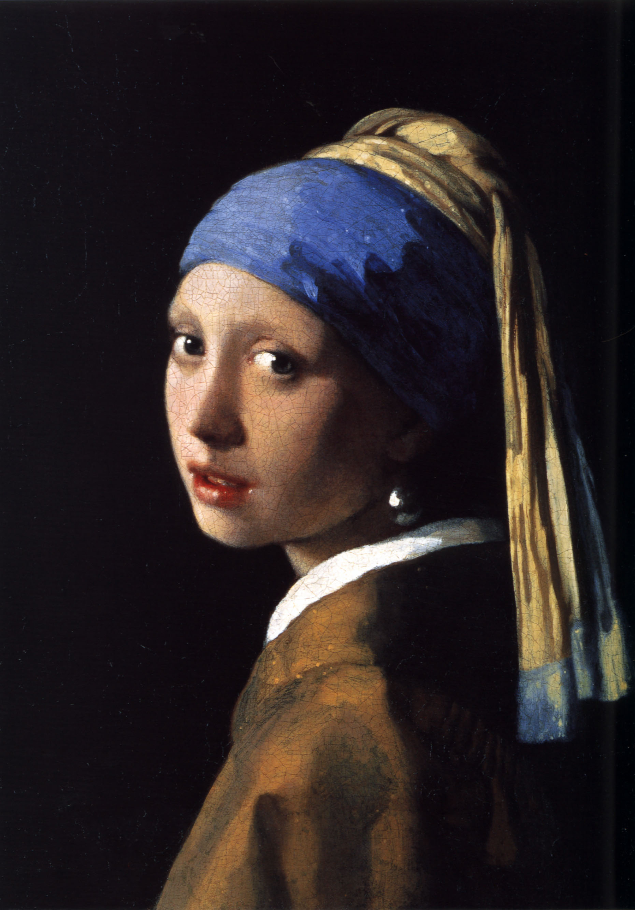
Johannes Vermeer, Girl with the Pearl Earring, c. 1670

Slide 28
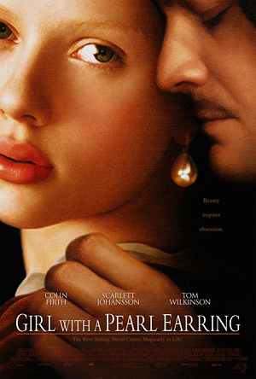
Johannes Vermeer, Girl with the Pearl Earring, c. 1670

Slide 29
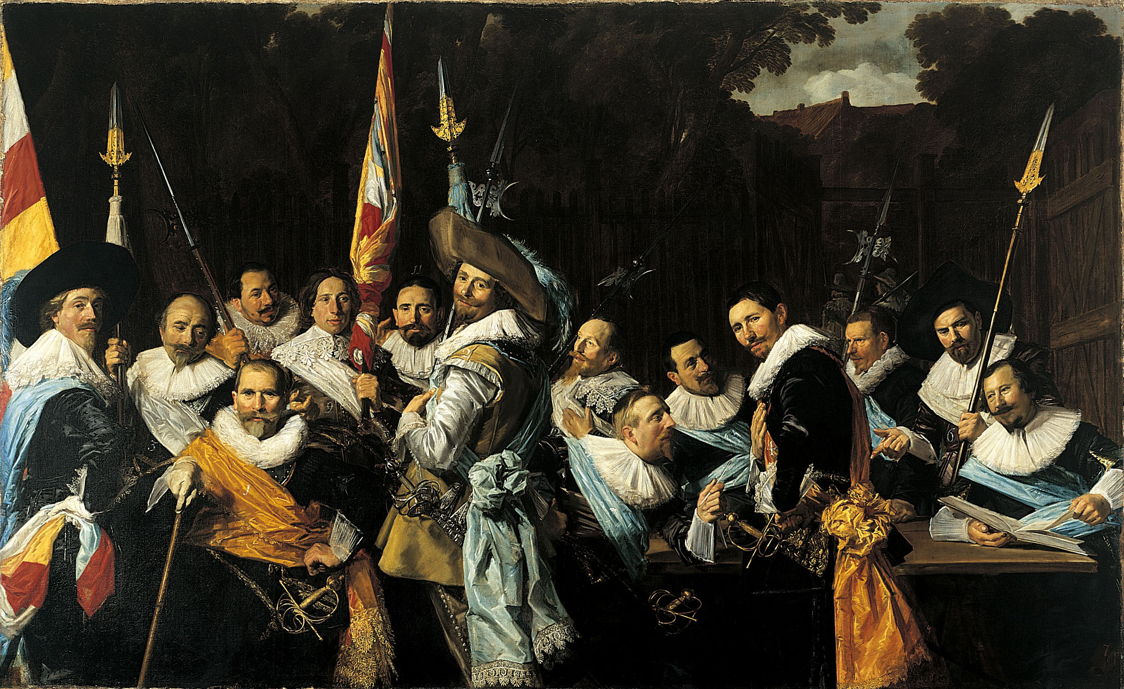
@ (25-10) Frans Hals, Archers of St. Hadrian, c. 1633 (6’9”x11’)

Slide 31
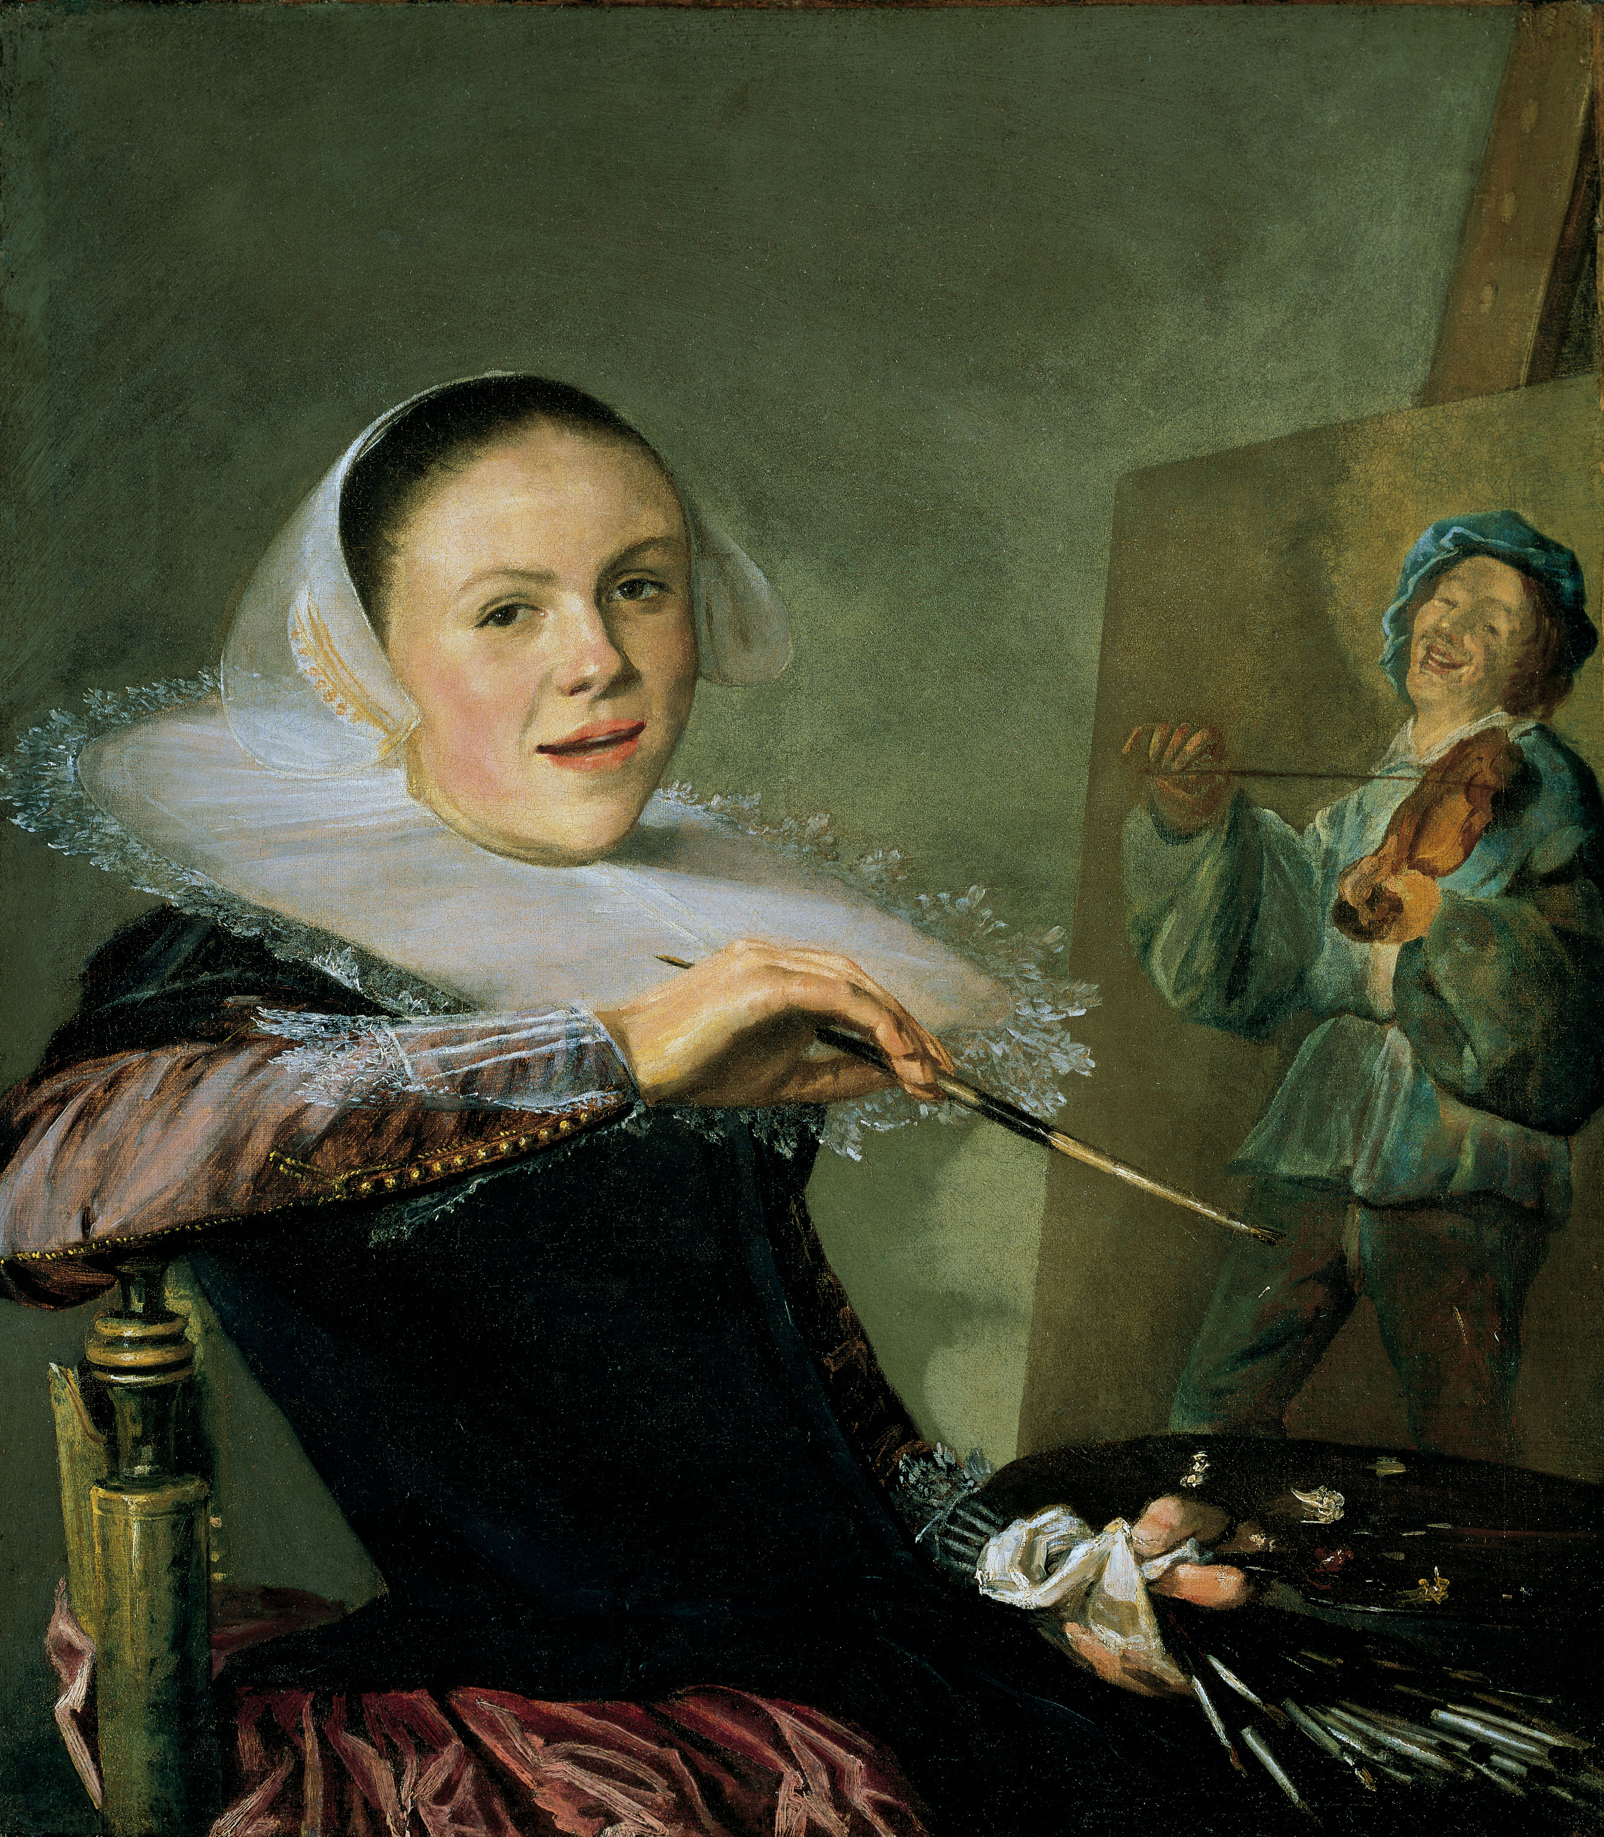
@ (25-11) Judith Leyster, Self Portrait, c. 1630

Slide 32
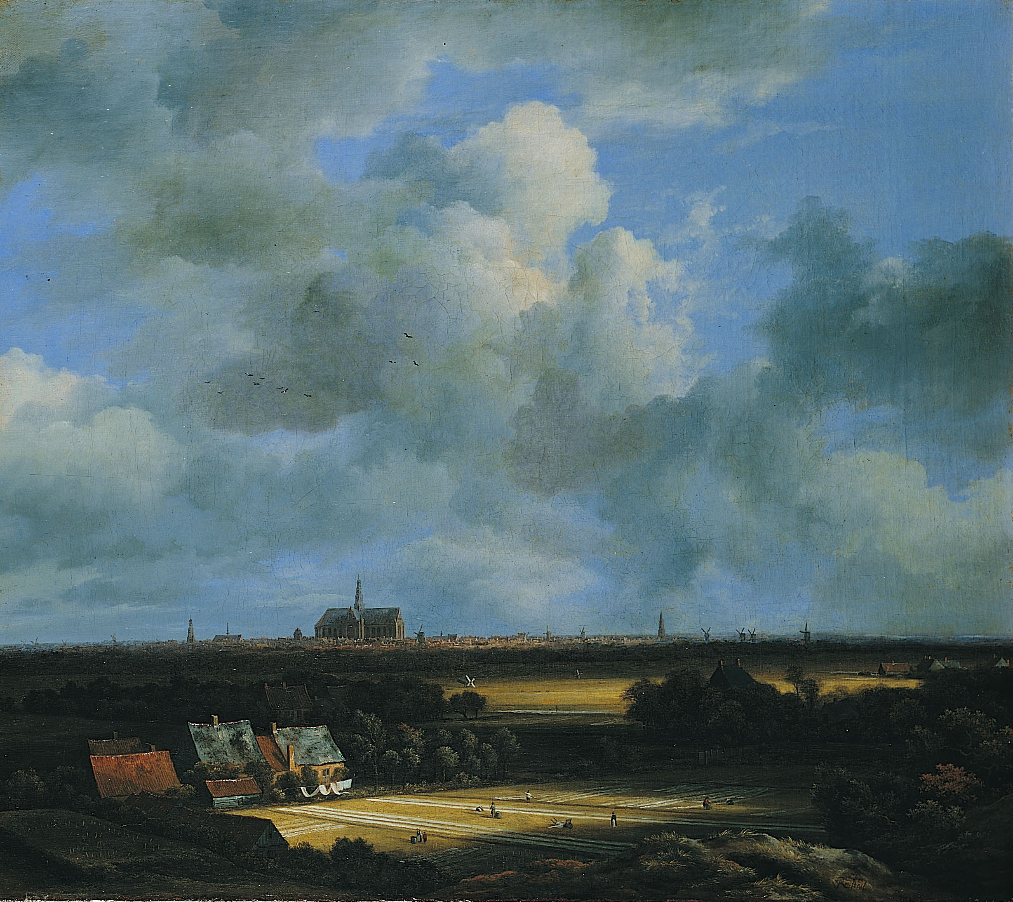
@ (25-18) Jacob van Ruisdael, View of Haarlem, c. 1670

Slide 33
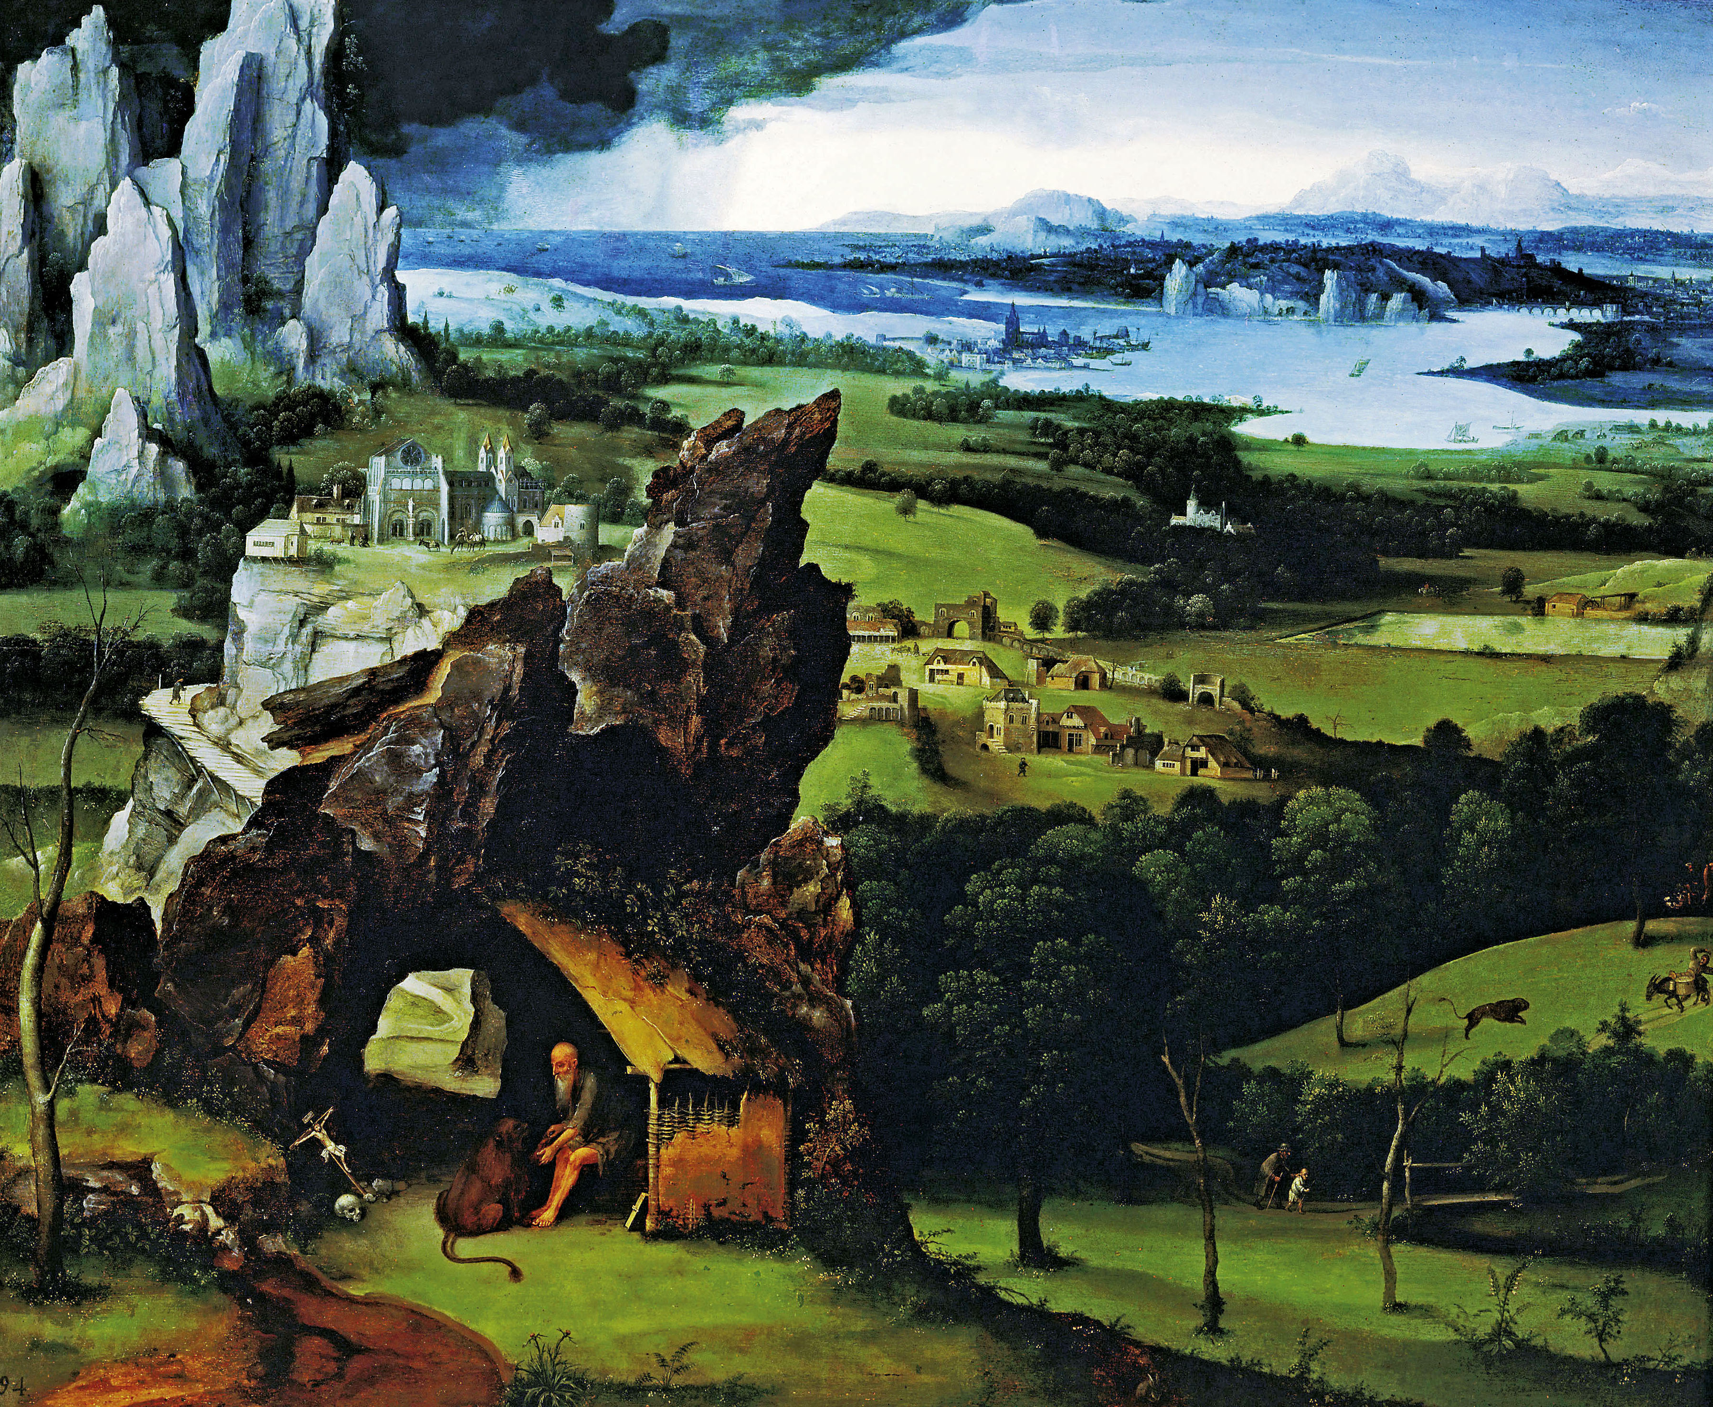
(23-18) Joachim Patenir, Landscape with St. Jerome, c. 1520-4
@ (25-18) Jacob van Ruisdael, View of Haarlem, c. 1670

Slide 34
@ (25-18) Jacob van Ruisdael, View of Haarlem, c. 1670

Slide 35
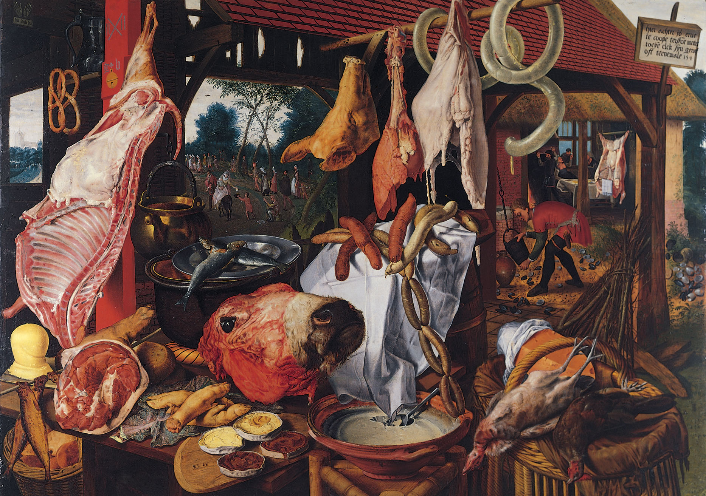
(23-15) Pieter Aertsen, Butcher’s Stall, 1551

Slide 36
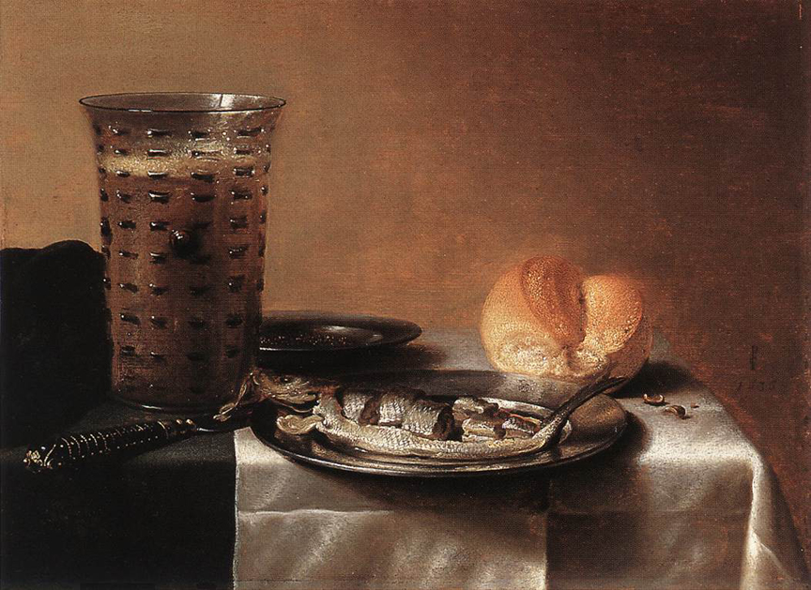
Pieter Claesz., Still Life with Beer and Herring, 1636

Slide 37
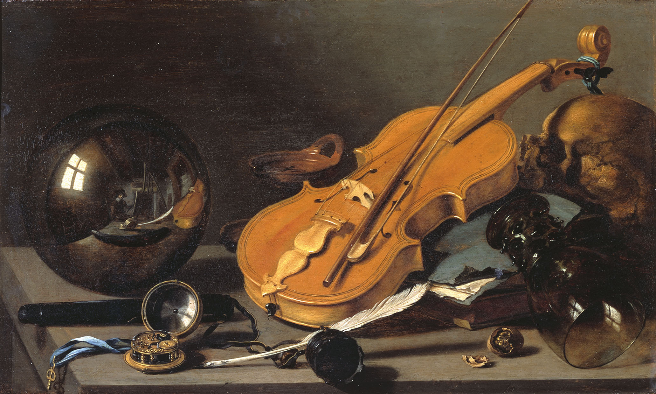
@ (25-21) Pieter Claesz., Vanitas Still Life, 1630s

Slide 38
“Vanitas” still life, from Ecclesiastes 1:2: “Vanitas vanitatum omnia vanitas” = “Vanity of vanities, all is vanity”
@ (25-21) Pieter Claesz., Vanitas Still Life, 1630s

Slide 39
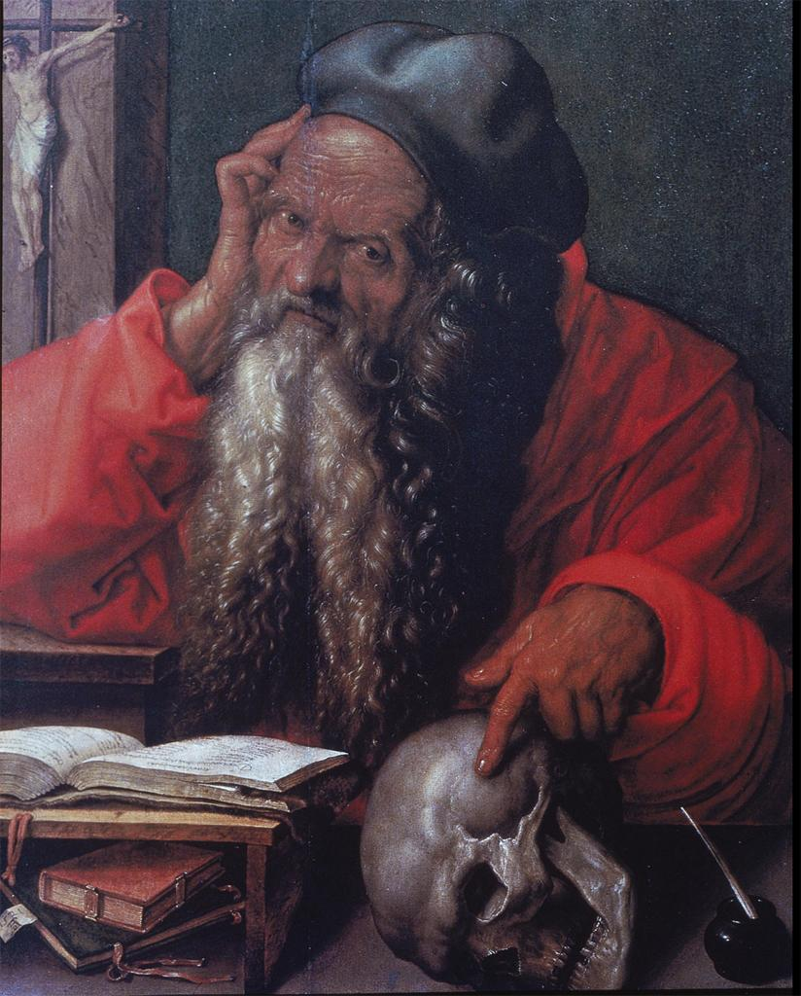
@ (25-21) Pieter Claesz., Vanitas Still Life, 1630s

Slide 40
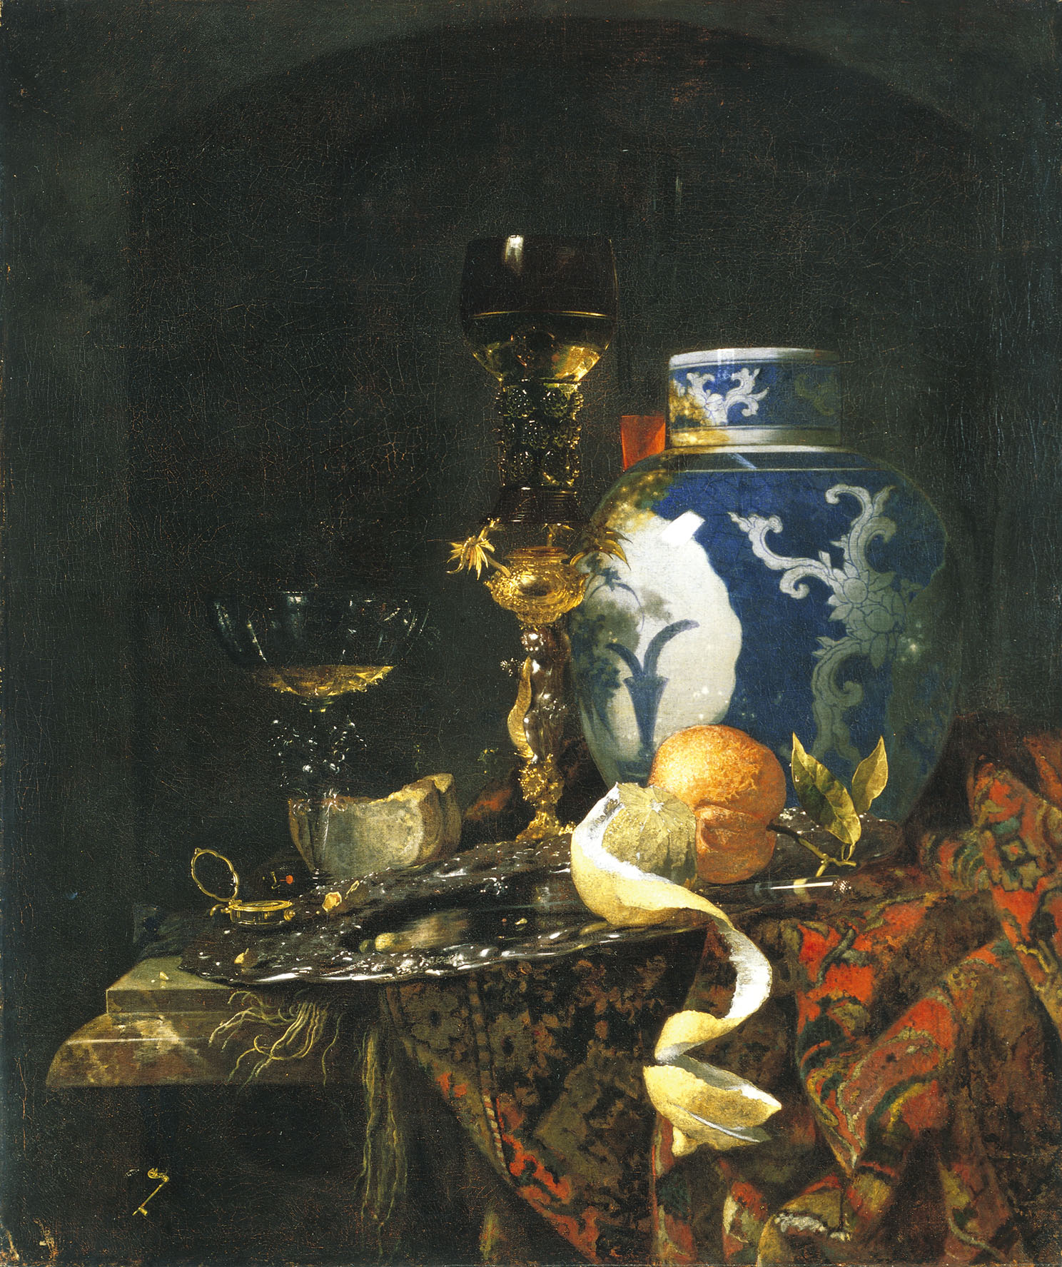
@ (25-22) Willem Kalf, Still-Life with a Late Ming Vase, 1669

Slide 41
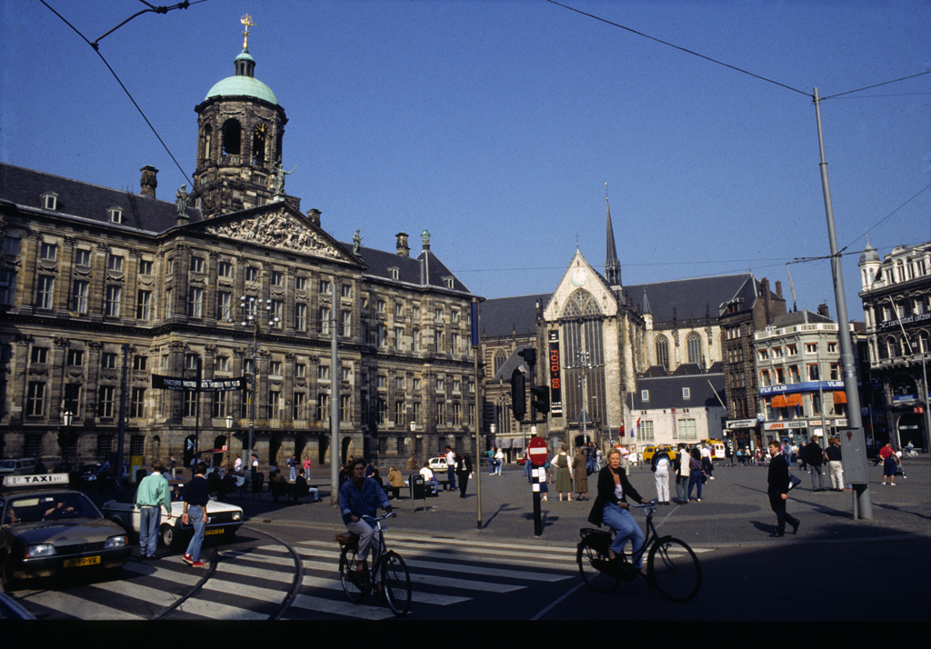

Slide 42
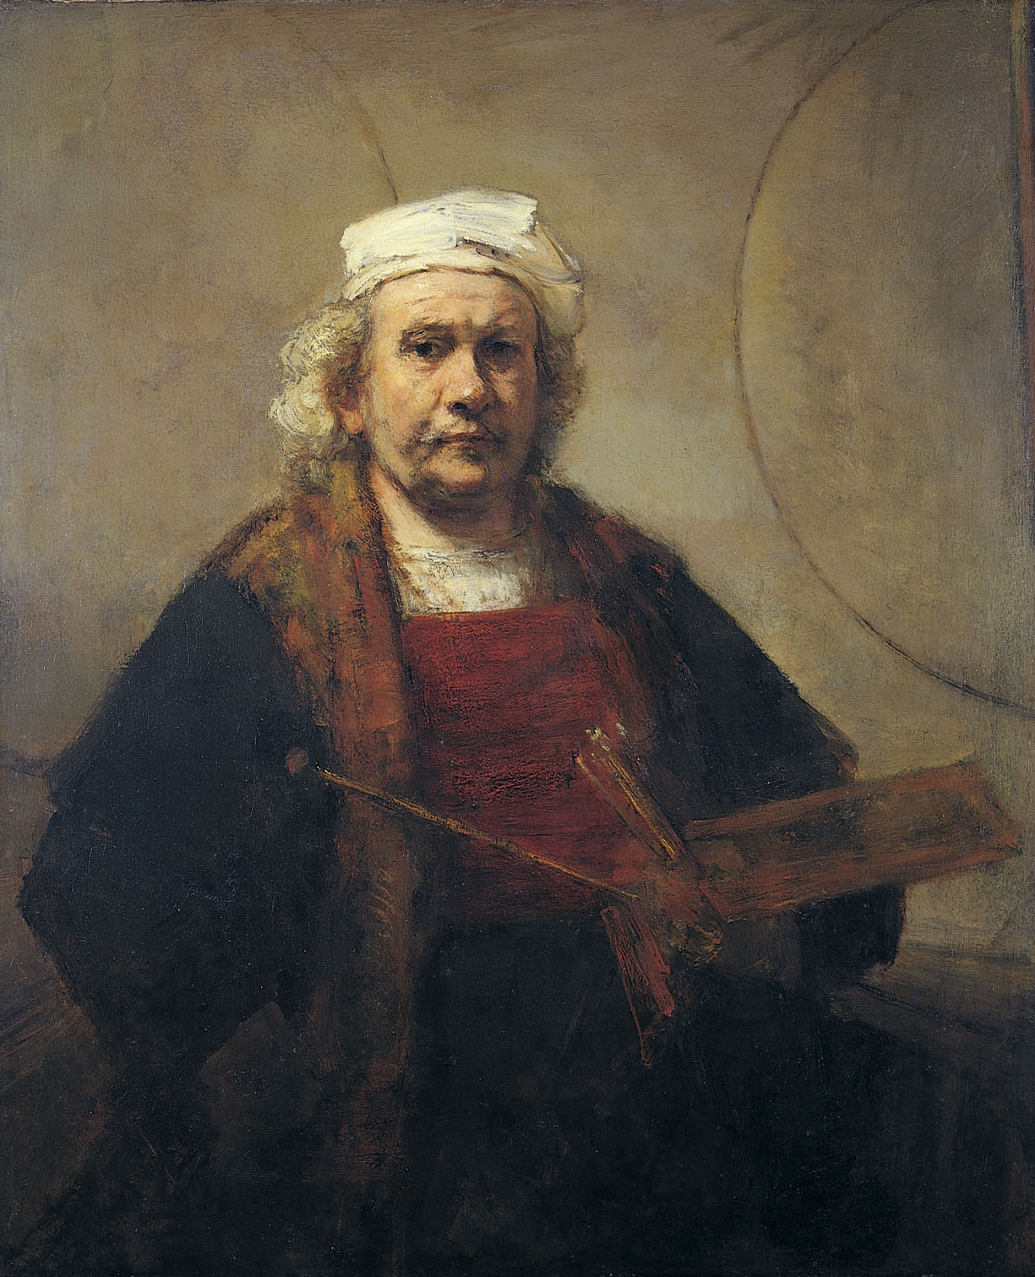
@ (25-15) Rembrandt van Rijn, Self-Portrait, c. 1659-60

Slide 43
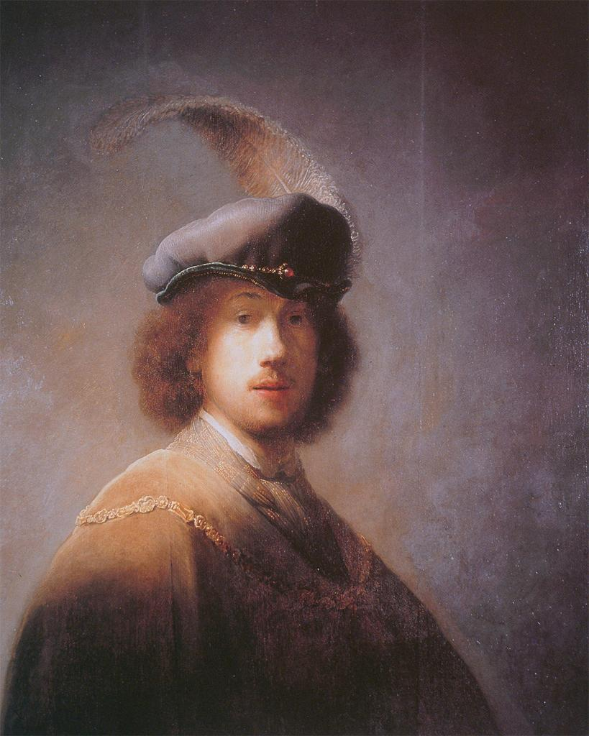
Rembrandt, Self Portrait, 1628, Gardner Museum, Boston
@ (25-15) Rembrandt van Rijn, Self-Portrait, c. 1659-60

Slide 44
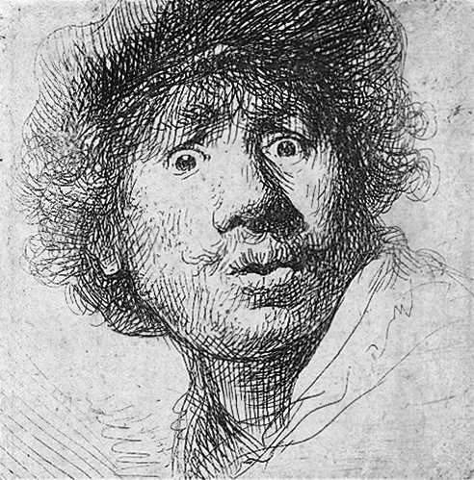
Rembrandt, Self Portrait with Startled Expression, 1630s, etching

Slide 45
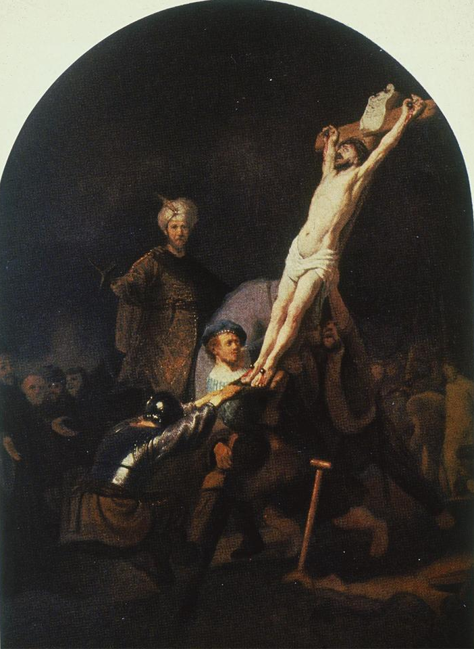
Rembrandt, Raising of the Cross, c. 1633

Slide 46
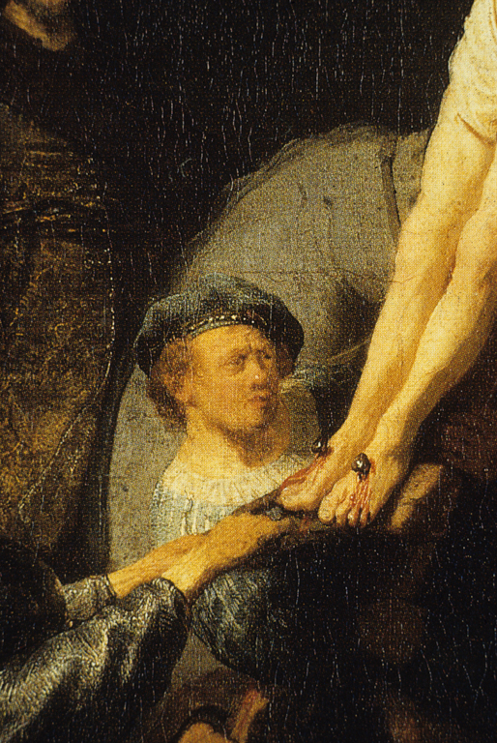
Rembrandt, Raising of the Cross, c. 1633

Slide 47
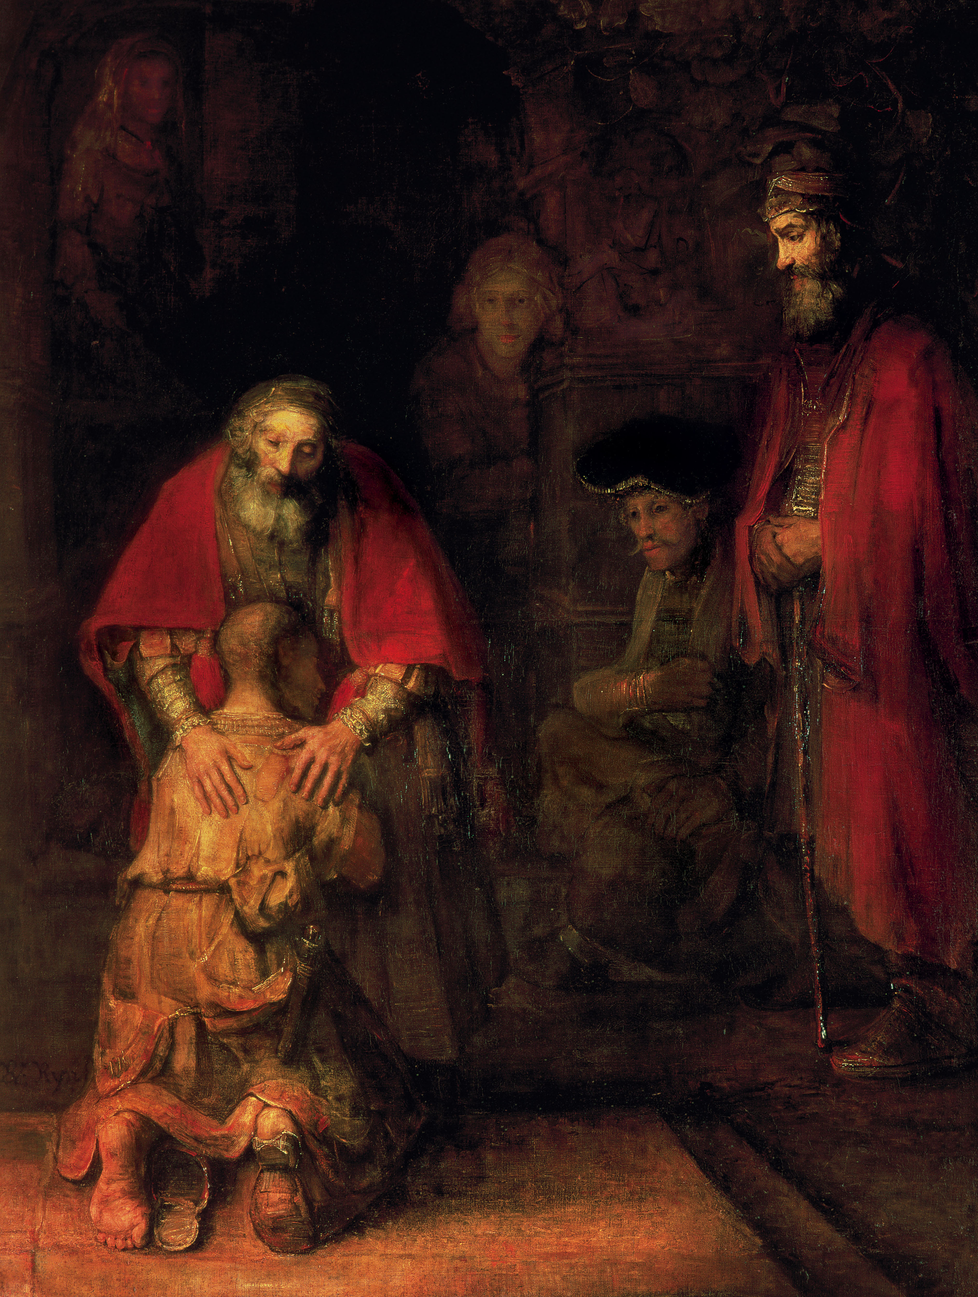
@ (25-14) Rembrandt van Rijn, Return of the Prodigal Son, c. 1665

Slide 48
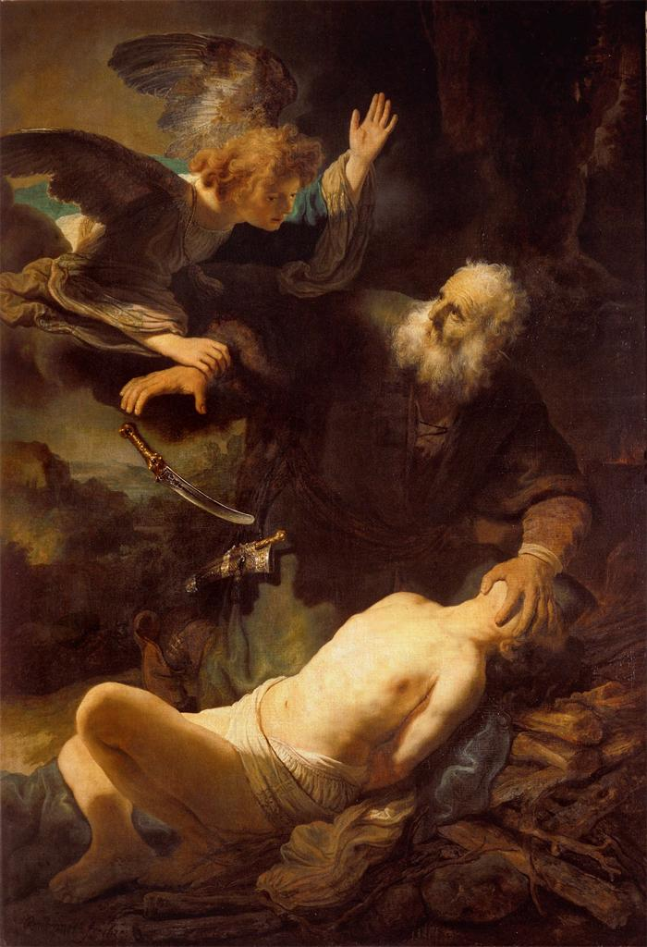
Rembrandt, Abraham Sacrificing Isaac, 1630s
@ (25-14) Rembrandt van Rijn, Return of the Prodigal Son, c. 1665

Slide 49
Rembrandt, Abraham Sacrificing Isaac, 1630s

Slide 50
Rembrandt, Abraham Sacrificing Isaac, 1630s
@ (25-14) Rembrandt van Rijn, Return of the Prodigal Son, c. 1665

Slide 51
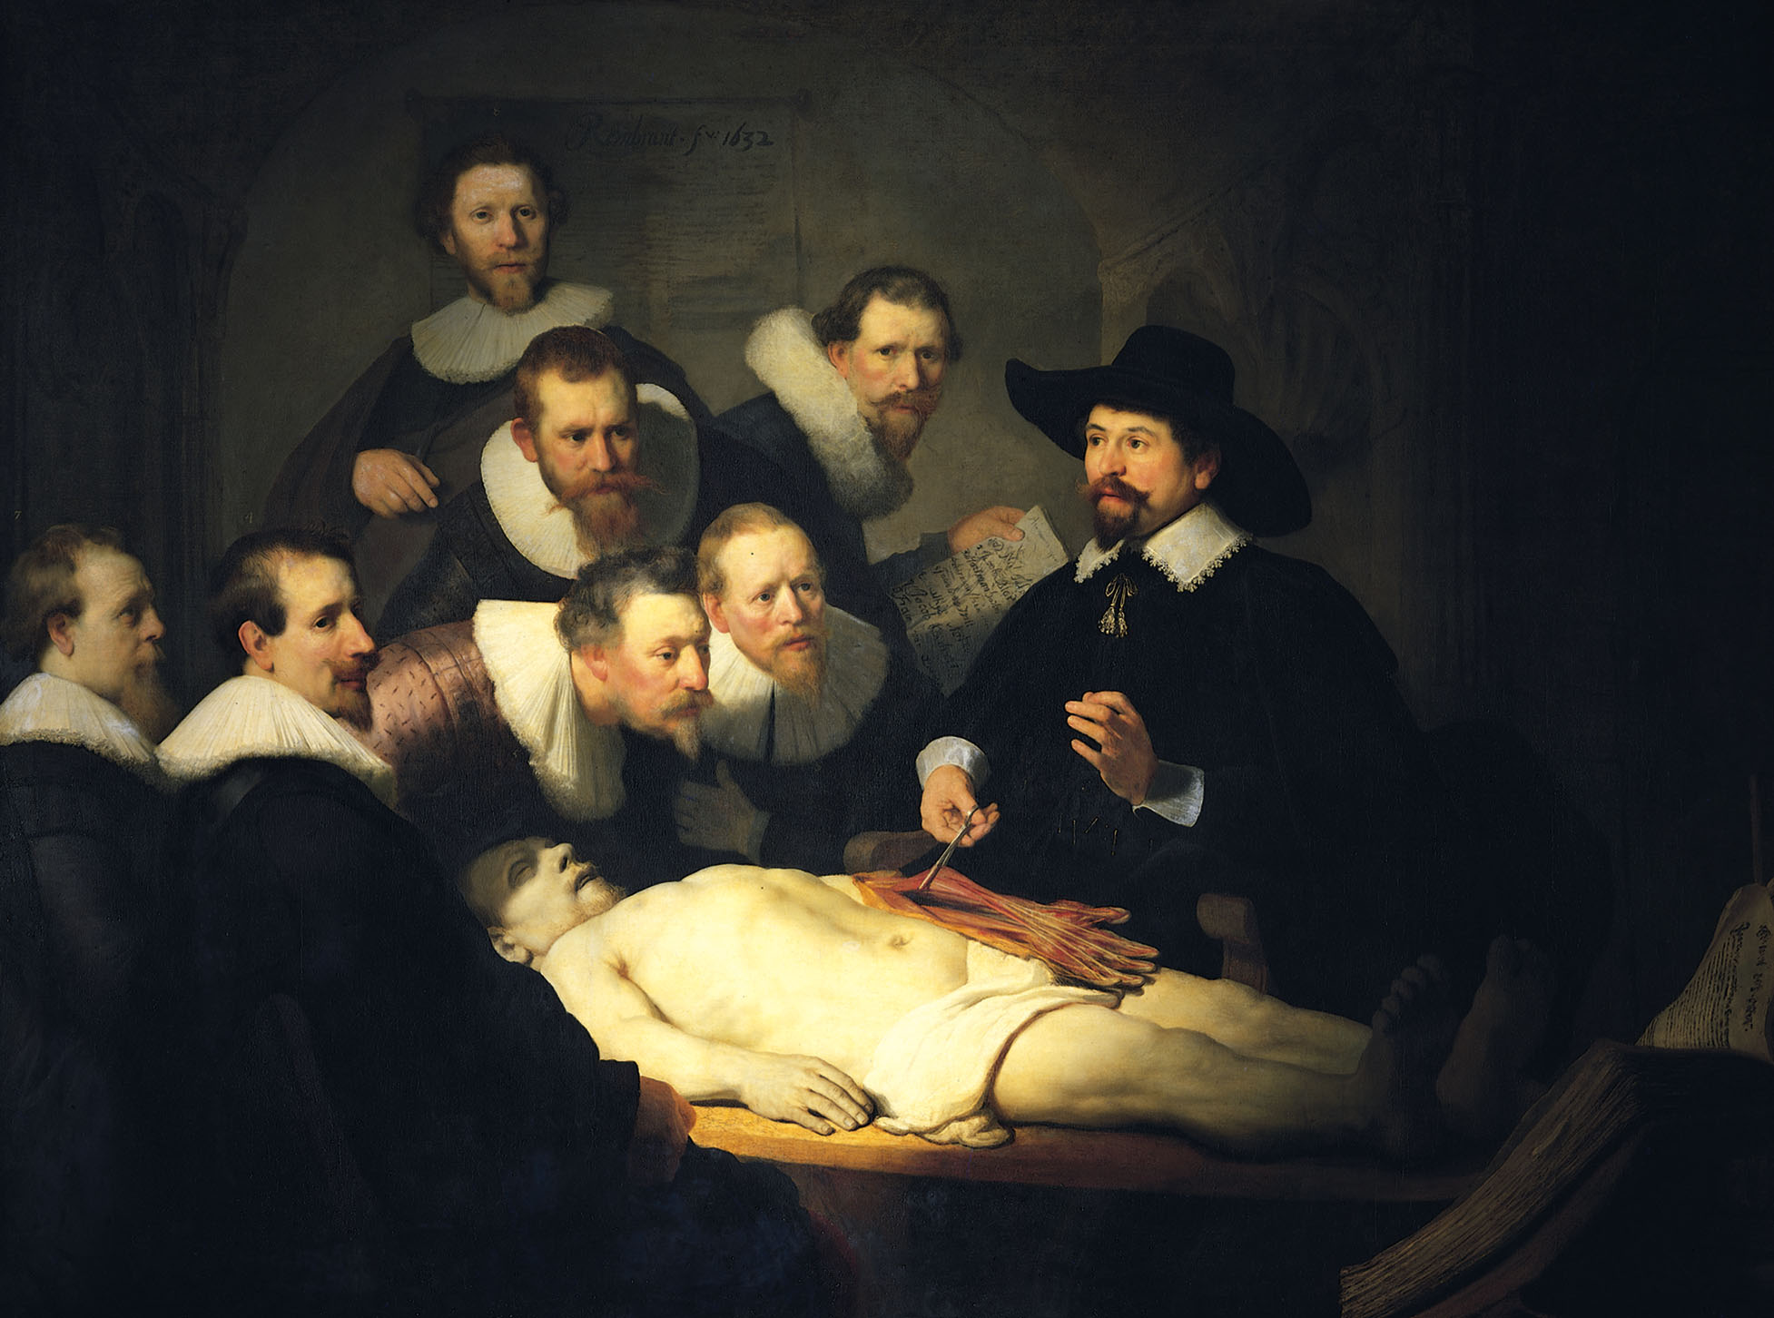
@ (25-12) Rembrandt, Anatomy Lesson of Dr. Tulp, 1632

Slide 52
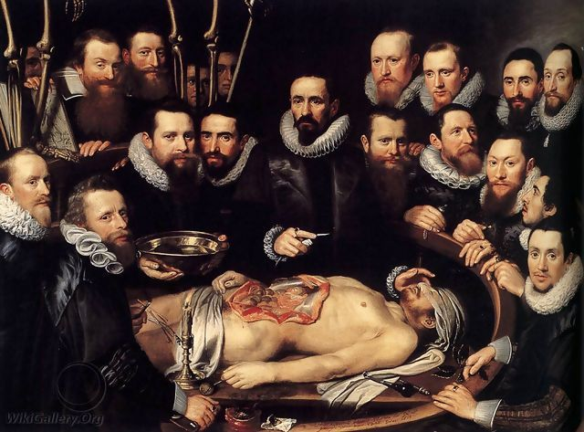
Michiel van Mierevelt, Anatomy Lesson

Slide 53
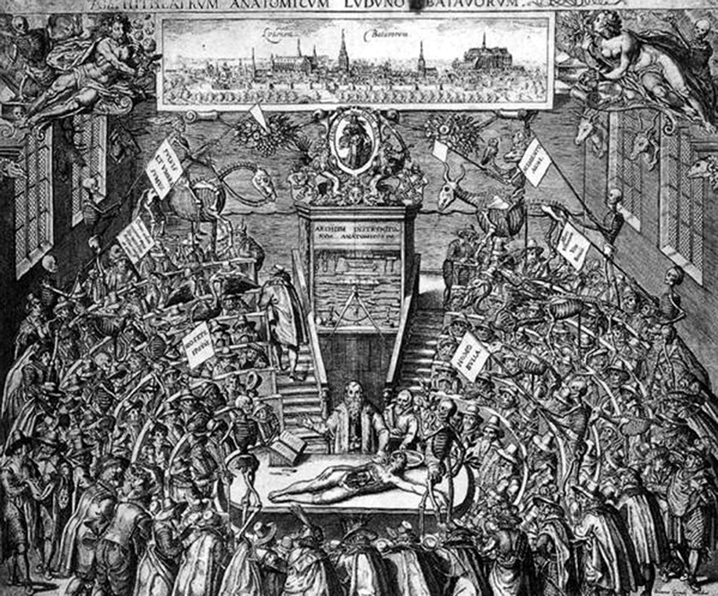
Anatomical Theatre in Leiden

Slide 54
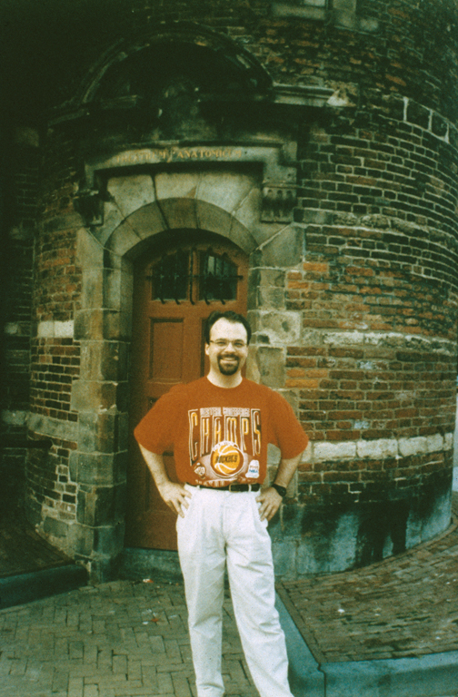
Photo of me in front of the St. Anthoniespoort/Waag in Amsterdam

Slide 55
@ (25-12) Rembrandt, Anatomy Lesson of Dr. Tulp, 1632

Slide 56
Caspar Barlaeus, 1639: “Evil men, who did harm when alive, do good after their deaths:/ Health seeks advantages from death itself./ Dumb integuments teach. Cuts of flesh, though dead, for that very reason forbid us to die./ Here, while with artful hand he slits the pallid limbs,/ The learned Tulp speaks eloquently to us:/ ‘Listener, come to know thyself [nosce teipsum], and while you proceed through the smallest parts,/ Believe that, even in the smallest, God lies hidden.”
@ (25-12) Rembrandt, Anatomy Lesson of Dr. Tulp, 1632

Slide 57
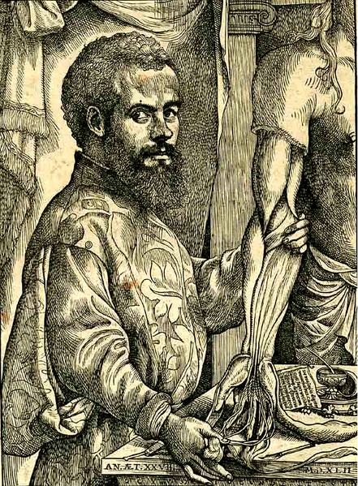
woodcut portrait of Andreas Vesalius
@ (25-12) Rembrandt, Anatomy Lesson of Dr. Tulp, 1632

Slide 58
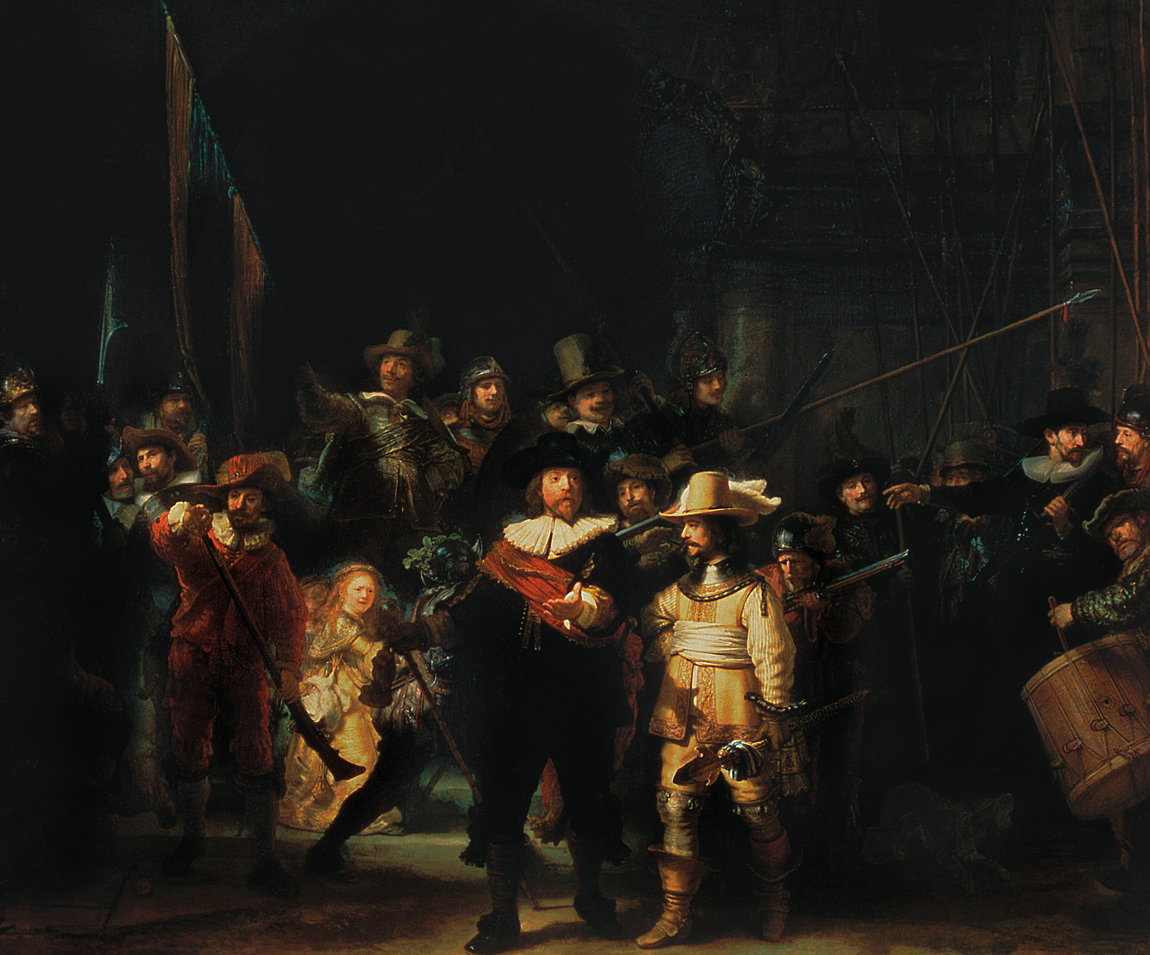
@ (25-13) Rembrandt, The Company of Capt. Frans Banning Cocq and Lt. Willem van Ruytenburgh (The Night Watch), 1642

Slide 59
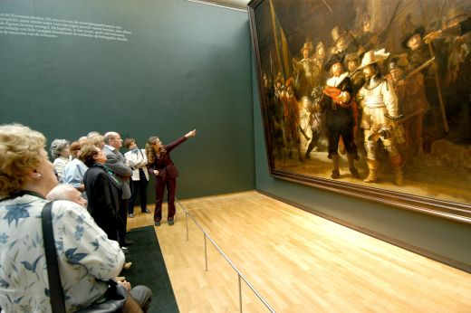

Slide 60
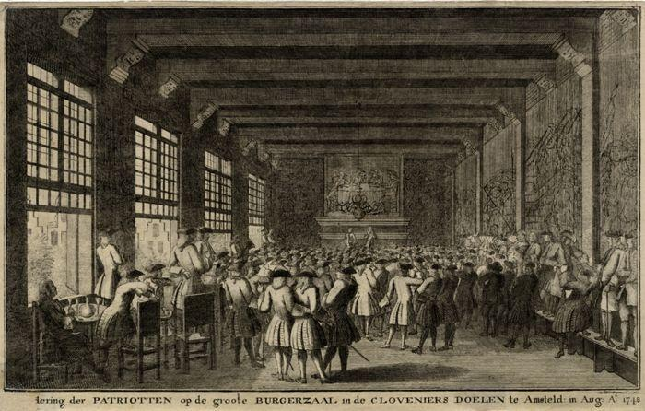

Slide 61
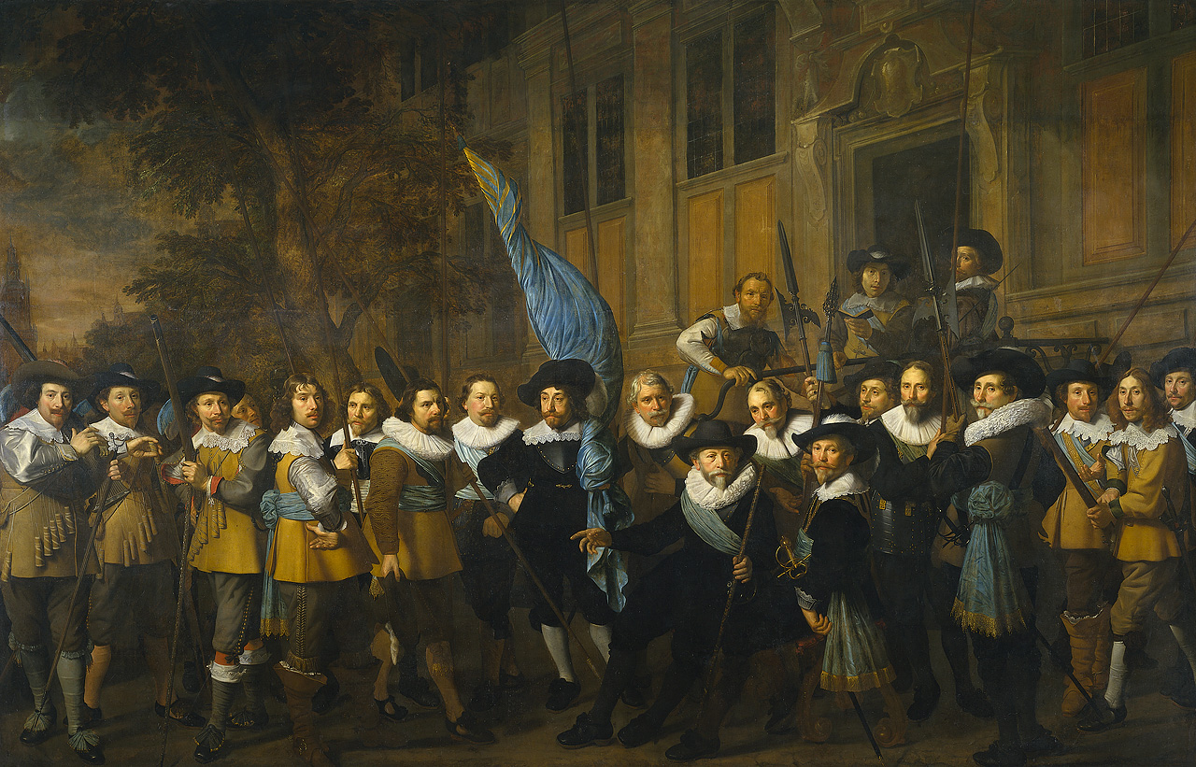
Nicolaes Eliasz., Militia Company Portrait, c. 1642

Slide 63
Samuel van Hoogstraeten (1678): “It is not acceptable that a painter should arrange the portraits all in rows next to each other, so that you could behead them all at once, as one sees here in Holland all too often in the paintings in the Schuttersdoelens. Real masters bring everything together so that the whole work is unified [eenwezig]…Rembrandt has observed this requirement very well in his piece in the Doele in Amsterdam, but in the opinion of many he went too far, making more work of the overall subject he preferred to depict than of the individual portraits he was commissioned to do. However, this painting, no matter how much we may criticize it, will survive all its competitors because it is so painterly [schilderachtich] in thought, so ingenious in the varied placement of the figures, and so powerful that in comparison, according to some, all the other pieces there look like decks of playing cards. Though I do wish he had painted it with a bit more light in it.”

Slide 64
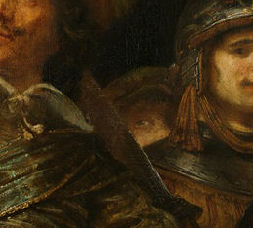

Slide 65
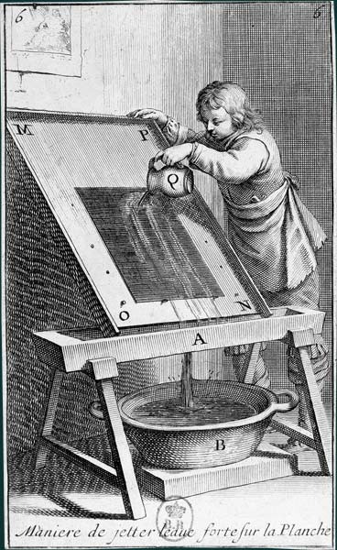
the process of making an etching

Slide 66

@ (25-16) Rembrandt, The Hundred Guilder Print, (etching and drypoint), c. 1649

Slide 68


Slide 69


Slide 70


Gerbrandt Bredero, Groot Liedt-Boeck, (1622), “Den Droevigen Vryer” (The Sad Lover): “This drink which gives joy to all, what use is it to me? While others find themselves side-by-side with their beloved, I sit here alone./ Their great happiness increases my dejection…/[So] I shall turn my gaze inward,/ And dream of My Lady…”

Slide 71


Slide 72


Slide 73


Slide 74



